Slide 1






Enhanced environmental protection inspection for efficient control of air quality monitoring and of all entities under obligation within system of greenhouse gas emission allowance trading, in order to achieve better quality of air in Republic of Croatia
This project is funded by the European Union

Slide 2



TOPIC 9: Normative regulation
Energy research and Environmental Protection Institute

Slide 3

9.1 HRN EN ISO/IEC 17025
European Union IPA 2013 Programme for Croatia
LABORATORIES
A body performing one or more of the following activities: examination, calibration, sampling related to incoming examination or calibration.
Air quality testing laboratories conduct pollutant concentration measurements in the air.
The calibration laboratories provide the measuring traceability of the analyzers that are conducting the measurements.
In what way any laboratory can prove its ability, impartiality, expertise and consistent work?
ANSWER: by applying the requirements of HRN EN ISO/IEC 17025.
Institut za energetiku i zaštitu okoliša
Energy Research and Environmental Protection Institute

Slide 4
9.1 HRN EN ISO/IEC 17025
European Union IPA 2013 Programme for Croatia
IMPORTANCE OF THE STANDARD
HRN EN ISO/IEC 17025 is a standard that provides requirements for laboratory qualification.
International standard HRN EN ISO/IEC 17025 promotes confidence in the laboratory work by setting requirements by fulfilling which laboratories can prove that their activities are conducted impartially, professionally and correctly in order to provide a quality results to their customers.
Laboratories operating in accordance with the requirements of HRN EN ISO/IEC 17025 are considered as skilled laboratories, and this ability can demonstrate to the accreditation body (in the RH: HAA) which, once it is found that all requirements are fulfilled, it can issue a certificate of accreditation, which is a formal proof of such qualification issued by a third independent party.
Institut za energetiku i zaštitu okoliša
Energy Research and Environmental Protection Institute

Slide 5
9.1 HRN EN ISO/IEC 17025
European Union IPA 2013 Programme for Croatia
HISTORICAL BACKGROUND
ISO/IEC 17025 is an internationally recognized laboratory qualification standard. Through the accreditation system, the results of accredited laboratories around the world are mutually recognized without further verification.
ISO/IEC 17025 is the basis for laboratory accreditation. It is used by all accreditation bodies in the world as a fundamental document by which the labs prove their own competence.
ISO/IEC 17025 encompasses management requirements (in compliance with ISO 9001) and technical requirements related to specific laboratory activities.
Institut za energetiku i zaštitu okoliša
Energy Research and Environmental Protection Institute

Slide 6
9.1 HRN EN ISO/IEC 17025
European Union IPA 2013 Programme for Croatia
HISTORICAL BACKGROUND
The European standard EN 45001: 1989, which is the forerunner of international standard HRN EN ISO/EC 17025, was published in 1989.
When the accreditation system started to develop in Croatia, this standard was accepted as HRN EN 45001:1996.
In 1998, the first certificates of accreditation of laboratories in Croatia were issued.
The International Standardization Organization, ISO, publishes an improved version of EN 45001 as ISO/IEC 17025: 1999, as the first edition of the International Standard for laboratory competence.
Institut za energetiku i zaštitu okoliša
Energy Research and Environmental Protection Institute

Slide 7
9.1 HRN EN ISO/IEC 17025
European Union IPA 2013 Programme for Croatia
HISTORICAL BACKGROUND
The first edition of ISO/IEC 17025: 1999 was adopted next year as the Croatian Publication of HRN EN ISO/EC 17025:2000.
The second edition of ISO/IEC 17025: 2005 published in 2005 is aligned with the latest issue of ISO 9001.
The Croatian editions are not accompanied by ISO/IEC publications, such as the second edition of ISO/IEC 17025: 2006 + AC: 2006 in the Republic of Croatia published in Croatian language as the fifth edition of HRN EN ISO/IEC 17025:2007.
The third edition of ISO/IEC 17025: 2017 was recently published (1.12.2017), and is in the process of being adopted worldwide. It brings a lot of news. Laboratories shall be complied with a new release until 1.12.2020.
Institut za energetiku i zaštitu okoliša
Energy Research and Environmental Protection Institute

Slide 8
9.1 HRN EN ISO/IEC 17025
European Union IPA 2013 Programme for Croatia
ACCREDITATION
Laboratories operating in accordance with HRN EN ISO/IEC 17025 can be accredited. Accreditation is a third independent party that confirms the laboratory competence.
The accreditation system is developing in each country. Each country has ONE accreditation body, as the umbrella organization of quality and acting independently.
The accreditation body evaluates the laboratory and if the laboratory proves its qualification according to ISO/IEC 17025, it obtains the accreditation certificate, with the exact area for which the laboratory is capable of carrying out its activities.
In Croatia, the Croatian Accreditation Agency (HAA) is the accreditation body.
Institut za energetiku i zaštitu okoliša
Energy Research and Environmental Protection Institute

Slide 9
9.1 HRN EN ISO/IEC 17025
European Union IPA 2013 Programme for Croatia
STANDARD STRUCTURE
HRN EN ISO/IEC 17025
Management requirements | Chapter 4 4.1-4.15
Technical requirements | Chapter 5 5.1-5.10
Institut za energetiku i zaštitu okoliša
Energy Research and Environmental Protection Institute

Slide 10
9.1 HRN EN ISO/IEC 17025
European Union IPA 2013 Programme for Croatia
 | Standard item
Organization | 4.1
Management system | 4.2
Document control | 4.3
Review of requests, tenders and contracts | 4.4
Subcontracting of tests and calibrations | 4.5
Purchasing services and supplies | 4.6
Service to the customer | 4.7
Complaints | 4.8
Control of nonconforming testing | 4.9
Improvement | 4.10
Corrective action | 4.11
Preventive action | 4.12
Control of records | 4.13
Internal audits | 4.14
Management reviews | 4.15
Institut za energetiku i zaštitu okoliša
Energy Research and Environmental Protection Institute

Slide 11
9.1 HRN EN ISO/IEC 17025
European Union IPA 2013 Programme for Croatia
 | Standard item
General | 5.1
PERSONNEL | 5.2
ACCOMMODATION AND ENVIRONMENTAL CONDITIONS | 5.3
TEST AND CALIBRATION METHODS | 5.4
EQUIPMENT | 5.5
MEASUREMENT TRACEABILITY | 5.6
SAMPLING | 5.7
HANDLING OF TEST AND CALIBRATION ITEMS | 5.8
ASSURING THE QUALITY OF RESULTS | 5.9
REPORTING THE RESULTS | 5.10
Institut za energetiku i zaštitu okoliša
Energy Research and Environmental Protection Institute

Slide 12
9.1 HRN EN ISO/IEC 17025
European Union IPA 2013 Programme for Croatia
4.1 ORGANIZATION
Laboratories must be a legally recognizable body (or organization within which the laboratory works)
It must be responsible for all its activities in any way (on a permanent lab locations, temporary locations, mobile or stationary)
It must work independently, professionally, consistently and impartially - it must not exist conflict of interest
The powers and responsibilities must be defined
An effective organization must be provided
There must be policies and procedures for protecting confidential information
There must be policies and procedures to ensure expertise, impartiality, judgments and consistency in work
Inter-relations within the laboratory have to be defined
Institut za energetiku i zaštitu okoliša
Energy Research and Environmental Protection Institute

Slide 13
9.1 HRN EN ISO/IEC 17025
European Union IPA 2013 Programme for Croatia
4.1 ORGANIZATION
There must be a responsible staff (Laboratory Manager)
Staff supervision must be carried out
There must be a person responsible for the management system (Laboratory Quality Representative)
Staff must be aware of the importance of their processes
They need to develop and maintain appropriate communication processes
This can be achieved by describing how the requirements are met in the manual or documented procedure.
Institut za energetiku i zaštitu okoliša
Energy Research and Environmental Protection Institute

Slide 14
9.1 HRN EN ISO/IEC 17025
European Union IPA 2013 Programme for Croatia
4.2 MANAGEMENT SYSTEM
Laboratories must establish, apply and maintain a management system in accordance with HRN EN ISO/IEC 17025
There must be:
Quality policy
Handbook and documentation with a defined hierarchy
Quality objectives
The board must decide on:
the development and implementation of the management system and its continuous improvement of its effectiveness
communication to the organization the importance of customer requests, regulations and others
ensuring the integrity when changes are made
Institut za energetiku i zaštitu okoliša
Energy Research and Environmental Protection Institute

Slide 15
9.1 HRN EN ISO/IEC 17025
European Union IPA 2013 Programme for Croatia
4.3 DOCUMENT CONTROL
Laboratories must have a documented process for control of documents, internal and external
There must be a list of documents that the lab uses
The procedure must ensure:
availability of valid documents
periodical review of documents
distribution of documents
invalid document control
keeping of old documents
uniqueness of document marking
Institut za energetiku i zaštitu okoliša
Energy Research and Environmental Protection Institute

Slide 16
9.1 HRN EN ISO/IEC 17025
European Union IPA 2013 Programme for Croatia
4.3 DOCUMENT CONTROL
implementation of changes in documents
procedures for modifying, reviewing and approving the document
the procedure for issuing the document
control of electronic documents
This can be achieved by describing how the requirements are met in appropriate documented procedure.
Institut za energetiku i zaštitu okoliša
Energy Research and Environmental Protection Institute

Slide 17
9.1 HRN EN ISO/IEC 17025
European Union IPA 2013 Programme for Croatia
4.4 REVIEW OF REQUESTS/TENDERS/CONTRACTS
Laboratories must have a documented procedure for reviewing the requests, tenders and contracts
The procedure must ensure:
that the laboratory at its disposal has the necessary resources
to properly select the method (testing, calibration, sampling)
to have the ability to fulfil the customer’s request
to fully arrange with the customer what does he look for
to conclude the job through the offer - by order or contract (everything must be defined; e.g. the method must be listed in the offer, order or contract)
to keep records of everything, all subsequent agreements and modifications.
This can be achieved by describing how the requirements are met in appropriate documented procedure.
Institut za energetiku i zaštitu okoliša
Energy Research and Environmental Protection Institute

Slide 18
9.1 HRN EN ISO/IEC 17025
European Union IPA 2013 Programme for Croatia
4.5 SUBCONTRACTING
Laboratories can subcontract part of the service, and this must be a documented procedure.
Subcontracting in the laboratory:
- due to unforeseen circumstances (lack of resources, equipment failure, temporary disability, …)
- permanent subcontracting (mediation and franchise agreements)
The laboratory may, under certain conditions, outsource part of the business to the subcontractor, if the customer agrees with it
Laboratory is responsible for subcontracting to its customer
The laboratory must have selection criteria and list of subcontractors
Institut za energetiku i zaštitu okoliša
Energy Research and Environmental Protection Institute

Slide 19
9.1 HRN EN ISO/IEC 17025
European Union IPA 2013 Programme for Croatia
4.6 PROCUREMENT
Laboratories must have documented policies and procurement procedures
The procedure must ensure:
procurement overview (services/equipment/chemicals...)
keep records of inspection and check after procurement
defining procurement criteria (purchasing items must include specifications)
to have the technical content of the procurement documents reviewed and approved prior to the release
to evaluate and rank the suppliers
to keep a list of suppliers
This can be achieved by describing how the requirements are met in appropriate documented procedure.
Institut za energetiku i zaštitu okoliša
Energy Research and Environmental Protection Institute

Slide 20
9.1 HRN EN ISO/IEC 17025
European Union IPA 2013 Programme for Croatia
4.7 SERVICE TO THE CUSTOMER
Laboratories must be willing to cooperate with the customer
In case the customer wishes to participate in the activities that the laboratory conducts, it must respect the confidentiality of other customers
Laboratories must collect and analyze feedback information from the customer (e.g. by polling the customer)
Feedback information should be used to improve efficiency
This can be achieved by describing how the requirements are met in appropriate documented procedure.
Institut za energetiku i zaštitu okoliša
Energy Research and Environmental Protection Institute

Slide 21
9.1 HRN EN ISO/IEC 17025
European Union IPA 2013 Programme for Croatia
4.8 COMPLAINTS
Laboratories must have documented policy and complaint handling procedure
The procedure must ensure a consistent investigation of the causes of the complaint
The records shall be kept on everything
This can be achieved by describing how the requirements are met in appropriate documented procedure.
Institut za energetiku i zaštitu okoliša
Energy Research and Environmental Protection Institute

Slide 22
9.1 HRN EN ISO/IEC 17025
European Union IPA 2013 Programme for Croatia
4.9 CONTROL OF NONCONFORMING TESTING
Laboratories must have documented policies and procedures for occurrence of nonconforming work
In case of occurrence of nonconforming work
responsibilities must be assigned, e.g. for termination of work, approval of continuation and similar
corrections must be made, if necessary inform the customer
evaluate the importance of nonconforming work
assess the need to initiate a corrective action
This can be achieved by describing how the requirements are met in appropriate documented procedure.
Institut za energetiku i zaštitu okoliša
Energy Research and Environmental Protection Institute

Slide 23
9.1 HRN EN ISO/IEC 17025
European Union IPA 2013 Programme for Croatia
4.10 IMPROVEMENT
The laboratory must continually improve the efficiency of its management system using:
quality policies,
quality objectives,
evaluation results,
data analysis,
corrective and preventive actions and
management reviews.
Institut za energetiku i zaštitu okoliša
Energy Research and Environmental Protection Institute

Slide 24
9.1 HRN EN ISO/IEC 17025
European Union IPA 2013 Programme for Croatia
4.11 CORRECTIVE ACTIONS
Laboratories must have documented policies and procedures for their application of corrective actions
When performing a corrective action, it must be:
analyzed the cause of nonconformity/problem
selected and applied the appropriate action
monitored the implementation and evaluation of the effectiveness of the action
in the toughest cases, conducted the internal audit
The application of the corrective action can be described in the appropriate documented procedure.
Institut za energetiku i zaštitu okoliša

Slide 25
9.1 HRN EN ISO/IEC 17025
European Union IPA 2013 Programme for Croatia
4.12 PREVENTIVE ACTIONS
The laboratory must identify the necessary improvements and possible sources of nonconformity, either of a technical nature or of a management system.
When performing a preventive action, it must be :
analyzed the cause of potential nonconformity/problem
applied and monitored the action plans
conducted the evaluation of the effectiveness of the action
The application of the preventive action can be described in the appropriate documented procedure.
Institut za energetiku i zaštitu okoliša
Energy Research and Environmental Protection Institute

Slide 26
9.1 HRN EN ISO/IEC 17025
European Union IPA 2013 Programme for Croatia
4.12 PREVENTIVE ACTIONS
The laboratory must identify the necessary improvements and possible sources of nonconformity, either of a technical nature or of a management system.
When performing a preventive action, it must be :
analyzed the cause of potential nonconformity/problem
applied and monitored the action plans
conducted the evaluation of the effectiveness of the action
The application of the preventive action can be described in the appropriate documented procedure.
Institut za energetiku i zaštitu okoliša
Energy Research and Environmental Protection Institute

Slide 27
9.1 HRN EN ISO/IEC 17025
European Union IPA 2013 Programme for Croatia
4.13 CONTROL OF RECORDS
documents vs. records
INFORMATION – A set of meaningful data.
DOCUMENT - Information together with the media on which it was written (media: printed, electronic - paper, computer, CD, DVD, USB, server...).
RECORD - A document that indicates the obtained results or provides evidence of performed actions.
Institut za energetiku i zaštitu okoliša
Energy Research and Environmental Protection Institute

Slide 28
9.1 HRN EN ISO/IEC 17025
European Union IPA 2013 Programme for Croatia
4.13 CONTROL OF RECORDS
The standard distinguishes:
Quality system records
- internal audit reports
- management report
- report on preventive or corrective actions...
Technical records
- records on testing
- staff records
- testing report ...
Institut za energetiku i zaštitu okoliša
Energy Research and Environmental Protection Institute

Slide 29
9.1 HRN EN ISO/IEC 17025
European Union IPA 2013 Programme for Croatia
4.13 CONTROL OF RECORDS
The laboratory must establish and maintain procedures for identifying, collecting, indexing, accessing, filling, storing, maintaining and deleting records
Records must be:
readable
safely stored
protected from access (confidentiality!)
with a defined retention period
with defined usage mode (use, copy...)
The application of the preventive action can be described in the appropriate documented procedure.
Institut za energetiku i zaštitu okoliša
Energy Research and Environmental Protection Institute

Slide 30
9.1 HRN EN ISO/IEC 17025
European Union IPA 2013 Programme for Croatia
4.13 CONTROL OF RECORDS
In addition, laboratories must define how to correct errors in records.
Observations, data and calculations must be recorded at the time they are performed and must be able to connect with these actions.
Records - proof of application of all requirements of the standard HRN EN ISO/IEC 17025!
The assessment of the requirements of HRN EN ISO/IEC 17025 is largely covered by the review and verification of the records.
Institut za energetiku i zaštitu okoliša
Energy Research and Environmental Protection Institute

Slide 31
9.1 HRN EN ISO/IEC 17025
European Union IPA 2013 Programme for Croatia
4.14 INTERNAL AUDIT
The laboratory must periodically and in accordance with a pre-determined plan and procedure conduct internal audits of its work to see if this work is permanently in conformity with the requirements of the standard - at least ONCE A YEAR
The following should be done:
carry out audits according to the established audit programme
organize by quality representative
ensure that audits are carried out by qualified and independent persons
take the necessary action when the audit findings point to the deviation
record the audit record
The application of internal audit can be described in the appropriate documented procedure.
Institut za energetiku i zaštitu okoliša
Energy Research and Environmental Protection Institute

Slide 32
9.1 HRN EN ISO/IEC 17025
European Union IPA 2013 Programme for Croatia
4.15 MANAGEMENT REVIEW
In accordance with the pre-established plan and procedure, the laboratory management shall periodically carry out the assessment of the laboratory management system to ensure its permanent suitability and efficiency - at least ONCE A YEAR
Management review includes:
- suitability of policies and procedures
- reports of management and supervisory staff
- the results of the latest internal audits
- corrective and preventive actions
- assessments carried out by external bodies
- results of interlaboratory comparisons or testing of abilities
- changes in scope and type of work
Institut za energetiku i zaštitu okoliša
Energy Research and Environmental Protection Institute

Slide 33
9.1 HRN EN ISO/IEC 17025
European Union IPA 2013 Programme for Croatia
4.15 MANAGEMENT REVIEW
- feedback from the customer
- complaints
- recommendations for improvement
- other important factors, such as quality management, resources and staff training.
The application of management review can be described in the appropriate documented procedure.
Institut za energetiku i zaštitu okoliša
Energy Research and Environmental Protection Institute

Slide 34
9.1 HRN EN ISO/IEC 17025
European Union IPA 2013 Programme for Croatia
5.1 GENERAL
Many factors determine the accuracy and reliability of testing and/or calibration conducted by the laboratory
These factors include contributions of:
human factors (5.2)
accommodation and environment conditions (5.3)
testing and calibration methods and their validation (5.4)
equipment (5.5)
measurement traceability (5.6)
sampling (5.7)
handling objects for testing and calibration (5.8).
Institut za energetiku i zaštitu okoliša
Energy Research and Environmental Protection Institute

Slide 35
9.1 HRN EN ISO/IEC 17025
European Union IPA 2013 Programme for Croatia
5.2 PERSONNEL
Personnel – one of the most important pillars of quality.
The criteria, powers and responsibilities of the functions must be defined
Education and training:
initial training (new person, new function)
continuous education and training (training programme!)
Management must indicate the needs and goals of staff training
Institut za energetiku i zaštitu okoliša
Energy Research and Environmental Protection Institute

Slide 36
9.1 HRN EN ISO/IEC 17025
European Union IPA 2013 Programme for Croatia
5.2 PERSONNEL
Training:
training program (which everyone must master)
evaluation of effectiveness (confirmation that the program is mastered and the person is trained)
Records on personnel:
certificates of education
certificates of training
records of permanent education
all records that confirm the abilities, knowledge and skills
Institut za energetiku i zaštitu okoliša
Energy Research and Environmental Protection Institute

Slide 37
9.1 HRN EN ISO/IEC 17025
European Union IPA 2013 Programme for Croatia
5.2 PERSONNEL
The laboratory management must ensure the training of all who:
- work with special equipment
- conduct tests and/or calibrations
- evaluate the results and
- sign test reports and calibration certificates
The followiing shall be defined:
job descriptions
personnel authority
hose who approve the reports
Application of personnel requests can be described in the appropriate documented procedure.
Institut za energetiku i zaštitu okoliša
Energy Research and Environmental Protection Institute

Slide 38
9.1 HRN EN ISO/IEC 17025
European Union IPA 2013 Programme for Croatia
5.3 ACCOMMODATION AND ENVIRONMENTAL CONDITIONS
Laboratory spaces must be correct for use
Fieldwork must be carried out in accordance with working conditions
Environmental conditions need to be recorded
Neighboring areas where nonconfirmity activities are carried out must be effectively separated
Measures should be taken to prevent mutually damaging effects
Measures should be taken to maintain the rooms in a laboratory
The application of internal audit can be described in the appropriate documented procedure.
Institut za energetiku i zaštitu okoliša
Energy Research and Environmental Protection Institute

Slide 39
9.1 HRN EN ISO/IEC 17025
European Union IPA 2013 Programme for Croatia
5.4 TESTING AND CALIBRATION METHODS
The laboratory must use appropriate methods and procedures for all testing (testing laboratory) or calibration (calibration laboratory) in the area of its operation.
Methods:
Standardized (ISO, IEC, EN, HRN...)
Non-standardized:
- developed by the laboratory
- customized standardized methods
- published in any way (journals, scientific texts...)
Institut za energetiku i zaštitu okoliša
Energy Research and Environmental Protection Institute

Slide 40
9.1 HRN EN ISO/IEC 17025
European Union IPA 2013 Programme for Croatia
5.4 TESTING AND CALIBRATION METHODS
All instructions, standards, manuals and reference data essential to the laboratory operation must be modernized and easily accessible to the personnel
The deviation from the testing and calibration method can only happen if the deviation is documented, technically justified and has been accepted by the customer
Validation methods - non-standardized methods must be validated.
Validation is a testimony by examining and gathering objective evidence that requirements for special intended use have been fulfilled.
Institut za energetiku i zaštitu okoliša
Energy Research and Environmental Protection Institute

Slide 41
9.1 HRN EN ISO/IEC 17025
European Union IPA 2013 Programme for Croatia
5.4 TESTING AND CALIBRATION METHODS
Estimation of measurement uncertainty
Measurement uncertainty: parameter assigned to the result of the measurements describing the dispersion values that could reasonably be attributed to the measured value.
When measuring uncertainty, all components of uncertainty must be taken into account which are important in that case, using appropriate analytical methods.
The components are divided into components of:
type A - statistical (repeteability)
type B – non-statistical (resolution, impact assessment of appropriate parameters, from technical data etc.)
Institut za energetiku i zaštitu okoliša
Energy Research and Environmental Protection Institute

Slide 42
9.1 HRN EN ISO/IEC 17025
European Union IPA 2013 Programme for Croatia
5.4 TESTING AND CALIBRATION METHODS
Budgeting and data transfers must be subjected to a systematic appropriate verifications.
Use of computers and automated equipment:
the computer programs developed by the laboratory must be documented;
appropriate validation of these programs must be undertaken;
data protection procedures must be applied;
computers and automated equipment must be maintained.
Institut za energetiku i zaštitu okoliša
Energy Research and Environmental Protection Institute

Slide 43
9.1 HRN EN ISO/IEC 17025
European Union IPA 2013 Programme for Croatia
5.5 EQUIPMENT
The laboratory shall be equipped with all equipment for sampling, measurement and testing required for the proper conduct of testing or calibration
Equipment and its program support used for testing, calibration and sampling must be capable of achieving the required accuracy and must meet the specifications relating to the tests concerned or calibration
Equipmentmust be operated by authorized personnel.
Equipment must be maintained, serviced if necessary, calibrated...
Institut za energetiku i zaštitu okoliša
Energy Research and Environmental Protection Institute

Slide 44
9.1 HRN EN ISO/IEC 17025
European Union IPA 2013 Programme for Croatia
5.5 EQUIPMENT
Equipment shall be:
uniquely recognizable (tag!)
calibrated according to the calibration program (calibrated equipment!)
contain information on the calibration (when it is calibrated, as long as it is valid)
supported by appropriate records (instructions, equipment datasheet...)
withdrawn from use if it is defective
protected against failure, overloading etc.
checked occasionally
Equipment requirements may be described in the appropriate documented procedure
Institut za energetiku i zaštitu okoliša
Energy Research and Environmental Protection Institute

Slide 45
9.1 HRN EN ISO/IEC 17025
European Union IPA 2013 Programme for Croatia
5.6 MEASUREMENT TRACEABILITY
Traceability: The characteristic of the measurement result or the value of the standard to which it is derived can be related to the reference standards that are realized by the SI unit (usually state or international) unbroken by a line of comparisons that have established uncertainties.
Measurement traceability requires a calibration hierarchy established!
Calibration: An action by which under certain conditions in the first step is established a relationship between the value with the measurement uncertainties provided by measurement standards and corresponding indicators to which the measurement uncertainties are assigned. In the second step, these data are used to establish relationship to obtain the measurement result
Institut za energetiku i zaštitu okoliša
Energy Research and Environmental Protection Institute

Slide 46
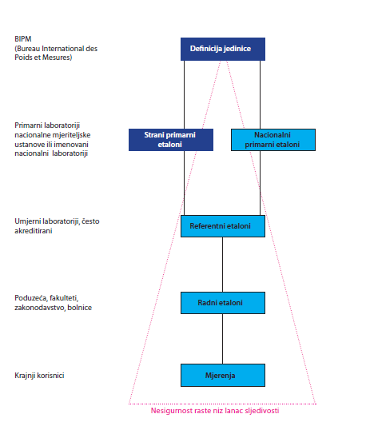
9.1 HRN EN ISO/IEC 17025
European Union IPA 2013 Programme for Croatia
5.6 MEASUREMENT
TRACEABILITY
Institut za energetiku i zaštitu okoliša
Energy Research and Environmental Protection Institute

Slide 47
9.1 HRN EN ISO/IEC 17025
European Union IPA 2013 Programme for Croatia
5.6 MEASUREMENT TRACEABILITY
Measurement traceability is provided by calibration laboratories!
Calibration is performed by:
Measurement standards (according to traceability chain: primary standard – national standard - reference standard - working standard – meter)
Certified Reference Materials (’’CRM’’)
Measurement traceability must be described in the laboratory management system documentation.
Institut za energetiku i zaštitu okoliša
Energy Research and Environmental Protection Institute

Slide 48
9.1 HRN EN ISO/IEC 17025
European Union IPA 2013 Programme for Croatia
5.7 SAMPLING
The laboratory must have a sampling plan and sampling procedures when conducting the sampling of substances, materials or products which are then tested or calibrated
The laboratory must have procedures for recording essential data and procedures that refer to the sampling that forms part of the testing or calibration.
All sampling records must be properly managed.
Institut za energetiku i zaštitu okoliša
Energy Research and Environmental Protection Institute

Slide 49
9.1 HRN EN ISO/IEC 17025
European Union IPA 2013 Programme for Croatia
5.8 HANDLING OF TEST AND CALIBRATION ITEMS
The laboratory must have procedures for transportation, reception, handling, protection, storing, storing or disposing of items being tested or calibrated, including all the provisions necessary to protect the integrity of the subjects being tested or calibrated and protect the interests of a laboratory or customer
The laboratory must have a system for recognizing the items being tested or calibrated.
Recognition must be retained throughout the course of the laboratory
The system must be planned and implemented to ensure that items cannot to be replaced physically or when referred to in records or other documents
Institut za energetiku i zaštitu okoliša
Energy Research and Environmental Protection Institute

Slide 50
9.1 HRN EN ISO/IEC 17025
European Union IPA 2013 Programme for Croatia
5.8 HANDLING OF TEST AND CALIBRATION ITEMS
Upon receipt of the item that will be tested or calibrated, the laboratory must record peculiraities or deviations from the usual or established conditions
Laboratory must have procedures and appropriate facilities and equipment to avoid the spoiling of the feature, loss or damage of the item being examined or calibrated
When items need to be stored or adjusted under established environmentally conditions, these conditions must be maintained, monitored and recorded
Institut za energetiku i zaštitu okoliša
Energy Research and Environmental Protection Institute

Slide 51
9.1 HRN EN ISO/IEC 17025
European Union IPA 2013 Programme for Croatia
5.9 ASSURING THE QUALITY OF RESULTS
The laboratory must have quality management procedures that serve as supervision of validity of the conducted tests and calibration
Quality control are work techniques and actions that are being undertaken to meet quality requirements.
Quality assurance covers the overall quality system measures that ensure the proper trust that the quality requirements will be fulfilled.
The laboratory must develop a quality control strategy.
Institut za energetiku i zaštitu okoliša
Energy Research and Environmental Protection Institute

Slide 52
9.1 HRN EN ISO/IEC 17025
European Union IPA 2013 Programme for Croatia
5.9 ASSURING THE QUALITY OF RESULTS
The quality control strategy encompasses the application of appropriate measures which prove the quality of the results.
These measures may be internal or external.
The laboratory must develop a quality control program that includes applicable external and internal quality control measures.
Quality control data must be analyzed and when it is found out they are out of pre-determined criteria, the planned corrective action must be taken to prevent the display of invalid results.
Institut za energetiku i zaštitu okoliša
Energy Research and Environmental Protection Institute

Slide 53
9.1 HRN EN ISO/IEC 17025
European Union IPA 2013 Programme for Croatia
5.9 ASSURING THE QUALITY OF RESULTS
Internal quality control measures are e.g.:
a) use of reference materials or quality control materials
b) use of traceable substitute instruments
c) functional inspection of measuring and test equipment
d) use of control or working standards with control charts
e) inter-inspection of measuring equipment
f) repeat testing or calibration using the same or different method
g) repeated testing or calibration of retained items
h) correlation of results for different properties of an item
i) comparisons within the laboratory
k) blind sample testing...
Institut za energetiku i zaštitu okoliša
Energy Research and Environmental Protection Institute

Slide 54
9.1 HRN EN ISO/IEC 17025
European Union IPA 2013 Programme for Croatia
5.9 ASSURING THE QUALITY OF RESULTS
External quality control measures are:
interlaboratory comparison
proficiency testing
Interlaboratory comparison is an organization, implementation and evaluation of the measurement or testing of the same or similar items in two or more laboratories under predetermined conditions.
Proficiency testing (PT) is evaluation of the participants according to predefined criteria by interlaboratory comparison.
Institut za energetiku i zaštitu okoliša
Energy Research and Environmental Protection Institute

Slide 55
9.1 HRN EN ISO/IEC 17025
European Union IPA 2013 Programme for Croatia
5.10 REPORTING THE RESULTS
The results of each testing or calibration conducted by the laboratory must be displayed accurately, clearly, unambiguously and objectively and in accordance with all specials instructions in testing and calibration methods.
The results are given in the form:
test report (test results, issued by the testing laboratory)
calibration certificates (calibration results; issued by the calibration laboratory)
sampling reports (sampling results; issued by the testing or calibration laboratory)
Institut za energetiku i zaštitu okoliša
Energy Research and Environmental Protection Institute

Slide 56
9.1 HRN EN ISO/IEC 17025
European Union IPA 2013 Programme for Croatia
5.10 REPORTING THE RESULTS
Test reports or calibration certificates must include:
a) title (e.g. "Test report" or "Calibration certificate")
b) name and address of the laboratory and the place where the activities were carried out
c) unique label
d) name and address of the customer;
e) mark of the method used
f) description and status of item being tested or calibrated
g) date of receipt of item being tested or calibrated where it is critical to validity and application of results and date(s) of testing or calibration
Institut za energetiku i zaštitu okoliša
Energy Research and Environmental Protection Institute

Slide 57
9.1 HRN EN ISO/IEC 17025
European Union IPA 2013 Programme for Croatia
5.10 REPORTING THE RESULTS
h) designation of the sampling plan and the procedures used by the laboratory or other bodies where they are important for validity or application of results;
i) testing or calibration results, where appropriate with the measuring units;
j) name, function and signature or equivalent label of the person approving the test report or calibration certificate;
k) where relevant, a statement that the results refer only to the items being tested or calibrated.
Institut za energetiku i zaštitu okoliša
Energy Research and Environmental Protection Institute

Slide 58
9.1 HRN EN ISO/IEC 17025
European Union IPA 2013 Programme for Croatia
5.10 REPORTING THE RESULTS
Opinions and Interpretations
When opinions and interpretations are involved, the laboratory must document the basis on which these opinions and interpretations are given.
In test report, opinions and interpretations must be clearly marked as such.
Opinions and interpretations do not accede to accreditation! (accreditation policy!)
Institut za energetiku i zaštitu okoliša
Energy Research and Environmental Protection Institute

Slide 59
9.1 HRN EN ISO/IEC 17025
European Union IPA 2013 Programme for Croatia
5.10 REPORTING THE RESULTS
Electronic transmission of results
In case of transmission of test results or calibration results by telephone, telex, fax or other electronic or electromagnetic means, the requirements of this international standard must be fulfilled
Report and certificate form
The report must be formatted in such a way that it is adapted to any type of testing or calibrations carried out and to minimize the possibility of misunderstanding or misuse
Institut za energetiku i zaštitu okoliša
Energy Research and Environmental Protection Institute

Slide 60
9.1 HRN EN ISO/IEC 17025
European Union IPA 2013 Programme for Croatia
ADDITIONAL REQUIREMENTS IN LABORATORY ACCREDITATION
Rules for accreditation
Although the basic document for laboratories accreditation is standard HRN EN ISO/IEC 17025, it is not the only one
Each accreditation body has rules that point to additional elements that refer to the accreditation process, as well as additional requirements for laboratories supplementing the needs for accreditation according to HRN EN ISO/IEC 17025
The accreditation rules also provide the obligations and responsibilities of accredited laboratories, and which laboratories are obliged to respect since from the moment of accreditation, accreditation body supervises the work of the accredited laboratory
Institut za energetiku i zaštitu okoliša
Energy Research and Environmental Protection Institute

Slide 61
9.1 HRN EN ISO/IEC 17025
European Union IPA 2013 Programme for Croatia
ADDITIONAL REQUIREMENTS IN LABORATORY ACCREDITATION
Calling for accredited laboratory status
Calling for accredited laboratory status is regulated in two ways:
Declarative sentence
Accreditation symbol
Declarative sentence:
The organization/laboratory is accredited (testing calibration) laboratory according to the standard HRN EN ISO/IEC 17025 by the Croatian Accreditation Agency in the field described in the attachment to the accreditation certificate No. xxxx.
Institut za energetiku i zaštitu okoliša
Energy Research and Environmental Protection Institute

Slide 62
9.1 HRN EN ISO/IEC 17025
European Union IPA 2013 Programme for Croatia
ADDITIONAL REQUIREMENTS IN LABORATORY ACCREDITATION
Accreditation symbol
The testing laboratories have the number of accreditation certificate and abbreviation ‚TEST’ on accreditation symbol;
The calibration laboratories have the number of accreditation certificate and abbreviation ‚CAL’ on accreditation symbol;
It is important to emphasize:
If the laboratory does not invoke the status of accreditation in its report (by sentence or symbol), such a report is not considered accredited!
Institut za energetiku i zaštitu okoliša
Energy Research and Environmental Protection Institute

Slide 63
9.1 HRN EN ISO/IEC 17025
European Union IPA 2013 Programme for Croatia
ADDITIONAL REQUIREMENTS IN LABORATORY ACCREDITATION
In the accreditation there are some special features that are further elaborated and to which in particular, places attention such as:
interlaboratory comparisons
traceability of results
measurement uncertainty estimation
presentation of the declaration of conformity
etc...
These additional details are elaborated in the rules and instructions of the accreditation body which the accredited laboratory must adhere to.
Institut za energetiku i zaštitu okoliša
Energy Research and Environmental Protection Institute

Slide 64
9.1 HRN EN ISO/IEC 17025
European Union IPA 2013 Programme for Croatia
ADDITIONAL REQUIREMENTS IN LABORATORY ACCREDITATION
Interlaboratory comparisons
Interlaboratory comparisons serve for comparisons of laboratory work
The results are compared with each other in order to conclude the laboratory's abilities in the pursuit of their activities
These results are most often processed statistically.
Statistical indicators have been developed that concern the abilities of the laboratory (e.g. z-value, En-number)
Institut za energetiku i zaštitu okoliša
Energy Research and Environmental Protection Institute

Slide 65
9.1 HRN EN ISO/IEC 17025
European Union IPA 2013 Programme for Croatia
ADDITIONAL REQUIREMENTS IN LABORATORY ACCREDITATION
Capability testing
When interlaboratory comparisons are used to control the quality of the testing results according to predefined criteria, then such an evaluation is called capability testing!
Capability testing is carried out by trained organizers.
The organizers are accredited according to HRN EN ISO/IEC 17043
Capability testing provided by accredited organizers serves laboratories as proof of external quality control as required by HRN EN ISO/IEC 17025
Institut za energetiku i zaštitu okoliša
Energy Research and Environmental Protection Institute

Slide 66
9.1 HRN EN ISO/IEC 17025
European Union IPA 2013 Programme for Croatia
ADDITIONAL REQUIREMENTS IN LABORATORY ACCREDITATION
Capability testing
According to the COMMISSION DIRECTIVE (EU) 2015/1480 of 28 August 2015 on the amendment of certain annexes to Directives 2004/107/EC and 2008/50/EC of the European Parliament and the Council on the establishment of rules for reference methods, data validation and location of sampling points for air quality assessment, Annex I, Section C:
’’National reference laboratory that organizes an interlaboratory comparison at national level should be accredited in accordance with the relevant harmonized standard for capability testing.’’
Institut za energetiku i zaštitu okoliša
Energy Research and Environmental Protection Institute

Slide 67
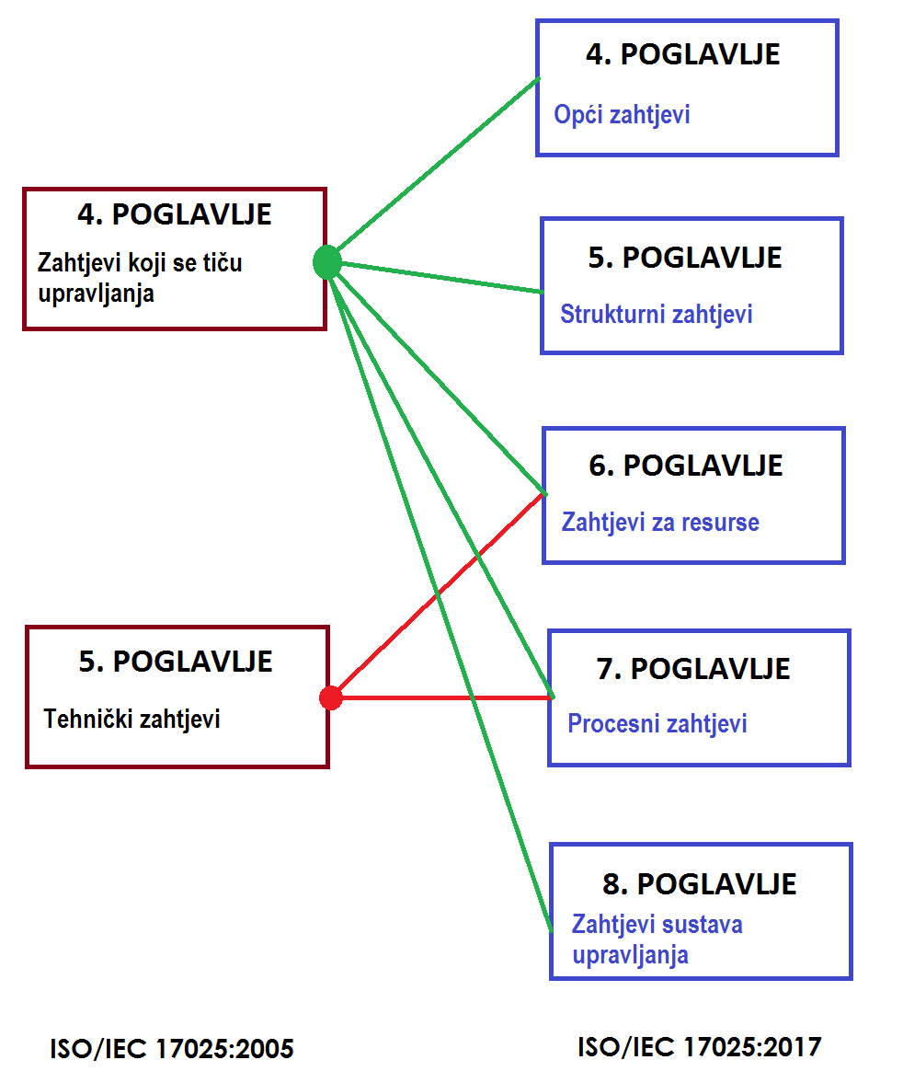
9.1 HRN EN ISO/IEC 17025
European Union IPA 2013 Programme for Croatia
NEW REQUIREMENTS ISO/IEC 17025:17025
- published on 1.12.2017.
- new structure
- new requirements
- adopted process approach
- management of impartiality
- risk and opportunities management
- information management
Institut za energetiku i zaštitu okoliša
Energy Research and Environmental Protection Institute

Slide 68
9.1 HRN EN ISO/IEC 17025
European Union IPA 2013 Programme for Croatia
SHORT OVERVIEW ON NEW EDITION ISO/IEC 17025:2017
Structure of standard
The standard is no longer divided into 2 main chapters, but the requirements are distributed into five chapters:
a) general requirements (Chapter 4)
b) structural requirements (Chapter 5)
c) resource requirements (Chapter 6)
d) process requirements (Chapter 7)
e) requirements of the management system (Chapter 8).
Institut za energetiku i zaštitu okoliša
Energy Research and Environmental Protection Institute

Slide 69
9.1 HRN EN ISO/IEC 17025
European Union IPA 2013 Programme for Croatia
SHORT OVERVIEW ON NEW EDITION ISO/IEC 17025:2017
Process approach
Chapter 7 – Process requirements – contains requirements from customer inquiries to report issuance:
7.1 Review of requests, tenders and contracts (''4.4'')
7.2 Selection, verification and validation of methods (''5.4'')
7.3 Sampling (''5.7'')
7.4 Handling of test and calibration items (''5.8'')
7.5 Technical records (''4.13.2'')
7.6 Assessment of measurement uncertainty (''5.4.6'')
Institut za energetiku i zaštitu okoliša
Energy Research and Environmental Protection Institute

Slide 70
9.1 HRN EN ISO/IEC 17025
European Union IPA 2013 Programme for Croatia
SHORT OVERVIEW ON NEW EDITION ISO/IEC 17025:2017
7.7 Assuring the quality of results (''5.9'')
7.8 Reporting the results (''5.10'')
7.9 Complaints (''4.8'')
7.10 Nonconforming testing (''4.9'')
7.11 Data control and information management (new + ''5.4.7'')
Institut za energetiku i zaštitu okoliša
Energy Research and Environmental Protection Institute

Slide 71
9.1 HRN EN ISO/IEC 17025
European Union IPA 2013 Programme for Croatia
SHORT OVERVIEW ON NEW EDITION ISO/IEC 17025:2017
Enhanced requirements
The following is asked from the laboratory :
management of impartiality
increased confidentiality requirements
more detailed reports
information management (laboratory information management system)
increased measures for the results validity (no more quality assurance of results but assurance of results validity)
risk management
Institut za energetiku i zaštitu okoliša
Energy Research and Environmental Protection Institute

Slide 72
9.1 HRN EN ISO/IEC 17025
European Union IPA 2013 Programme for Croatia
SHORT OVERVIEW ON NEW EDITION ISO/IEC 17025:2017
Simplified requirements
What is facilitated in the new release of the standard is:
application of management system (given the possibility of a management system build on ISO 9001)
less documentation requirements
no application of preventive actions is required, this is covered by risk management
Institut za energetiku i zaštitu okoliša
Energy Research and Environmental Protection Institute

Slide 73
9.1 HRN EN ISO/IEC 17025
European Union IPA 2013 Programme for Croatia
SHORT OVERVIEW ON NEW EDITION ISO/IEC 17025:2017
Transfer to a new edition
At present laboratories are accredited according to HRN EN ISO/IEC 17025:2007 (ISO/IEC 17025:2005).
New standard was published on December 1, 2017, and from that moment initiates the THREE-YEAR PERIOD of transferring to anew edition.
Until 1.12.2020. all accredited laboratories will have to align with the new release standard, ISO/IEC 17025: 2017, or their accreditations cease to be valid.
Institut za energetiku i zaštitu okoliša
Energy Research and Environmental Protection Institute

Slide 74
9.2 REFERENCE AND EQUIVALENT METHODS
European Union IPA 2013 Programme for Croatia
REFERENCE METHODS
Reference measurement methods for determining the concentration of SO2, NO2, CO, O3, benzene, PM10, PM2.5 and total gaseous mercury are defined in the Ordinance on the Air Quality Monitoring (OG 3/13), Annex 7 (Methods of Measurement), Part I,
Pollutant | Principle of measurement/analytical method | Method of measurement
SO₂ | UV fluorescence | HRN EN 14212:2012 – Standard method for the measurement of the concentration of sulphur dioxide by ultraviolet fluorescence (EN 14212:2012)
NO/NO₂ | Chemiluminescence | HRN EN 14211:2012 – Standard method for the measurement of the concentration of nitrogen dioxide and nitrogen monoxide by chemiluminescence (EN 14211:2012)
CO | IR spectroscopy | HRN EN 14626:2012 – Standard method for the measurement of the concentration of carbon monoxide by non-dispersive infrared spectroscopy (EN 14626:2011)
O₃ | UV absorption | HRN EN 14625:2012 – Standard method for the measurement of the concentration of ozone by ultraviolet photometry (EN 14625:2012)
Institut za energetiku i zaštitu okoliša
Energy Research and Environmental Protection Institute

Slide 75
9.2 REFERENCE AND EQUIVALENT METHODS
European Union IPA 2013 Programme for Croatia
REFERENCE METHODS
Pollutant | Principle of method | Method of measurement
Benzene | GC-PID or GC-FID | HRN EN 14662-1:2007 – Standard method for measurement of benzene concentrations - Part 1: Pumped sampling followed by thermal desorption and gas chromatography (EN 14662-1:2005) HRN EN 14662-2:2007 – Part 2: Pumped sampling followed by solvent desorption and gas chromatography (EN 14662-1:2005), HRN EN 14662-3:2007 – Part 3: Automated pumped sampling with in situ gas chromatography (EN 14662-1:2005)
PM₁₀ | Gravimetric | HRN EN 12341:2006 – Determination of the PM 10 fraction of suspended particulate matter - Reference method and field test procedure to demonstrate reference equivalence of measurement methods (EN 12341:1998)
PM_{2.5} | Gravimetric | HRN EN 14907:2006 – Standard gravimetric measurement method for the determination of the PM2,5 mass fraction of suspended particulate matter (EN 14907:2005)
Total gaseous mercury | CV AAS or CV AFS | HRN EN 15852:2010 – Standard method for the determination of total gaseous mercury
Institut za energetiku i zaštitu okoliša
Energy Research and Environmental Protection Institute

Slide 76
9.2 REFERENCE AND EQUIVALENT METHODS
European Union IPA 2013 Programme for Croatia
REFERENCE METHODS
According to the DIRECTIVE 2008/50/EC OF THE EUROPEAN PARLIAMENT AND OF THE COUNCIL of 21 May 2008 on air quality and clean air for Europe, ANNEX VI, Reference methods for estimation of the concentration of sulphur dioxide, nitrogen dioxide and nitrogen oxides, particulate matter (PM 10 and PM 2,5), lead, benzene, carbon monoxide and ground-level ozone :
Reference method for the measurement of sulphur dioxide
Reference method for the measurement of sulphur dioxide is described in EN 14212:2012‚ Ambient air – Standard method for the measurement of the concentration of sulphur dioxide by ultraviolet fluorescence.
Institut za energetiku i zaštitu okoliša
Energy Research and Environmental Protection Institute

Slide 77
9.2 REFERENCE AND EQUIVALENT METHODS
European Union IPA 2013 Programme for Croatia
REFERENCE METHODS
Reference method for the measurement of nitrogen dioxide and nitrogen oxides
Reference method for the measurement of nitrogen dioxide and nitrogen oxides is described in EN 14211:2012‚ Ambient air – Standard method for the measurement of the concentration of nitrogen dioxide and nitrogen monoxide by chemiluminescence.
Reference method for lead sampling and measurement
Reference method for lead sampling and measurement is described in Part A (4) of this Appendix. Reference method for lead measurement is described in EN 14902:2005 „Standard method for the measurement of Pb, Cd, As and Ni in the PM10 fraction of suspended particulate matter”.
Institut za energetiku i zaštitu okoliša
Energy Research and Environmental Protection Institute

Slide 78
9.2 REFERENCE AND EQUIVALENT METHODS
European Union IPA 2013 Programme for Croatia
REFERENCE METHODS
Reference method for sampling and measurement of PM 10
Reference method for sampling and measurement of PM10 is described in EN 12341:2014‚ Ambient air – Standard gravimetric measurement method for the determination of the PM10 or PM2,5 mass concentration of suspended particulate matter’.
Reference method for sampling and measurement of PM 2,5
Reference method for sampling and measurement of PM2,5 is described in EN 12341:2014‚ Ambient air – Standard gravimetric measurement method for the determination of the PM10 or PM2,5 mass concentration of suspended particulate matter’.
Institut za energetiku i zaštitu okoliša
Energy Research and Environmental Protection Institute

Slide 79
9.2 REFERENCE AND EQUIVALENT METHODS
European Union IPA 2013 Programme for Croatia
REFERENCE METHODS
Reference method for sampling and measurement of benzene
Reference method for sampling and measurement of benzene is described in EN 14662:2005, parts 1, 2 and 3 „Ambient air quality - Standard method for measurement of benzene concentrations”.
Reference method for measurement of carbon monoxide
Reference method for measurement of carbon monoxide is described in EN 14626:2012‚ Ambient air – Standard method for the measurement of the concentration of carbon monoxide by non-dispersive infrared spectroscopy’.
Institut za energetiku i zaštitu okoliša
Energy Research and Environmental Protection Institute

Slide 80
9.2 REFERENCE AND EQUIVALENT METHODS
European Union IPA 2013 Programme for Croatia
REFERENCE METHODS
Reference method for measurement of ground-level ozone
Reference method for measurement of ground-level ozone is described in EN normi 14625:2012‚ Ambient air – Standard method for the measurement of the concentration of ozone by ultraviolet photometry’.
Institut za energetiku i zaštitu okoliša
Energy Research and Environmental Protection Institute

Slide 81

9.2 REFERENCE AND EQUIVALENT METHODS
European Union IPA 2013 Programme for Croatia
HRN EN 14212:2012
Ambient air – Standard method for the measurement of the concentration of sulphur dioxide by ultraviolet fluorescence
This standard has a correction:
HRN EN 14212:2012/Cor.1:2014 (EN 14212:2012/AC:2014)
This European standard establishes a method for continuous measurement for determination of concentrations of sulphur dioxide in the ambient air on the measurement principle of ultraviolet fluorescence.
The standard describes the performance characteristics and sets the minimum criteria required for selecting the appropriate analyzer.
It also includes an assessment of the suitability of the analyzer for use on the monitoring station to meet the data quality requirements in accordance with the Directive 2008/50/EC.
Institut za energetiku i zaštitu okoliša
Energy Research and Environmental Protection Institute

Slide 82

9.2 REFERENCE AND EQUIVALENT METHODS
European Union IPA 2013 Programme for Croatia
HRN EN 14212:2012
MEASUREMENT AREA
0 - 1000 µg/m³
(0 - 376 nmol/mol)
MEASUREMENT PRINCIPLE
UV FLUORESCENCE
Institut za energetiku i zaštitu okoliša
Energy Research and Environmental Protection Institute

Slide 83
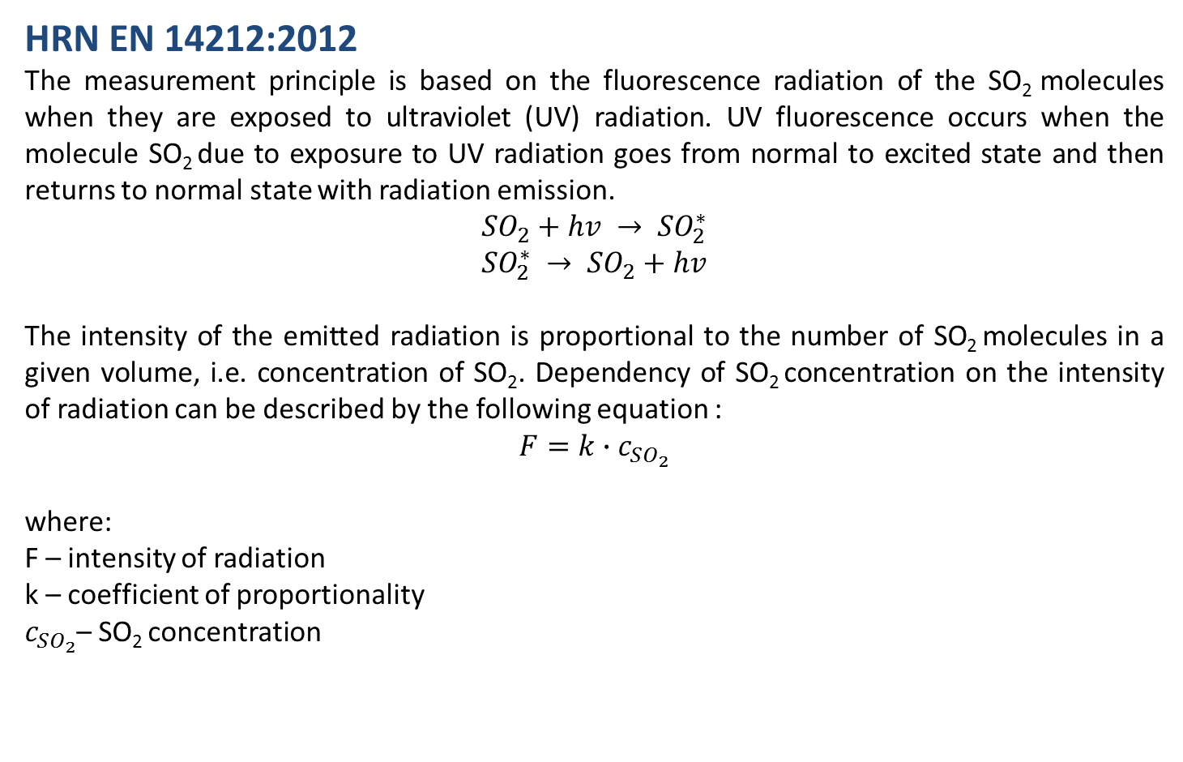
9.2 REFERENCE AND EQUIVALENT METHODS
European Union IPA 2013 Programme for Croatia
HRN EN 14212:2012
The measurement principle is based on the fluorescence radiation of the SO₂ molecules when they are exposed to ultraviolet (UV) radiation. UV fluorescence occurs when the molecule SO₂ due to exposure to UV radiation goes from normal to excited state and then returns to normal state with radiation emission.
$${SO}_{2}+hv → {SO}_{2}^{∗}$$
$${SO}_{2}^{∗} → {SO}_{2}+hv$$
The intensity of the emitted radiation is proportional to the number of SO₂ molecules in a given volume, i.e. concentration of SO₂. Dependency of SO₂ concentration on the intensity of radiation can be described by the following equation :
$$F=k∙c_{SO_{2}}$$
where:
F – intensity of radiation
k – coefficient of proportionality
$c_{SO_{2}}$– SO₂ concentration
Institut za energetiku i zaštitu okoliša
Energy Research and Environmental Protection Institute

Slide 84
9.2 REFERENCE AND EQUIVALENT METHODS
European Union IPA 2013 Programme for Croatia
HRN EN 14212:2012
Before entering the reaction chamber, the air is filtered and passed through a hydrocarbon scrabber that would otherwise cause interference. Then the air enters the reaction chamber where it is, under standardized conditions, exposed to UV rays in the wavelength area between 200 and 220 nm. When returning from excited to the normal state, the SO₂ molecules emit radiation in the range of wavelengths between 240 and 420 nm. This emission is, by using selective optical filters, transformed into an electric signal by a photoconductor or a photodiode. The electrical signal is measured and its intensity is proportional to the number of molecules, i.e. at standardized conditions of SO₂ concentration which entered the reaction.
Concentrations of SO₂ are measured directly into volume/volume units (ppb) since the absorption in the IR spectrum is proportional to the concentration of SO₂ in volume/volume units. After obtaining concentration in ppb values, the result is converted to μg/m³ using standard conversion factors for a temperature of 20 °C and a pressure of 101.3 kPa whereat:
1 ppb (nmol/mol) SO₂ = 2,66 µg/m3 SO₂
Institut za energetiku i zaštitu okoliša
Energy Research and Environmental Protection Institute

Slide 85
9.2 REFERENCE AND EQUIVALENT METHODS
European Union IPA 2013 Programme for Croatia
HRN EN 14212:2012
Institut za energetiku i zaštitu okoliša
Energy Research and Environmental Protection Institute

Slide 86
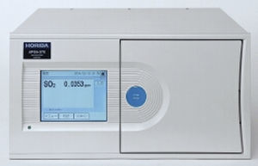
9.2 REFERENCE AND EQUIVALENT METHODS
European Union IPA 2013 Programme for Croatia
HRN EN 14212:2012
EQUIPMENT
HORIBA – APSA 370
Institut za energetiku i zaštitu okoliša
Energy Research and Environmental Protection Institute

Slide 87
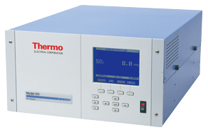
9.2 REFERENCE AND EQUIVALENT METHODS
European Union IPA 2013 Programme for Croatia
HRN EN 14212:2012
EQUIPMENT
THERMO SCIENTIFIC
– MODEL 43i
Institut za energetiku i zaštitu okoliša
Energy Research and Environmental Protection Institute

Slide 88
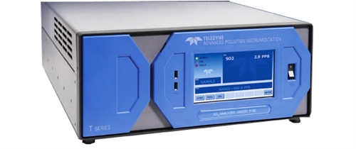
9.2 REFERENCE AND EQUIVALENT METHODS
European Union IPA 2013 Programme for Croatia
HRN EN 14212:2012
EQUIPMENT
TELEDYNE
– API T100
Institut za energetiku i zaštitu okoliša
Energy Research and Environmental Protection Institute

Slide 89
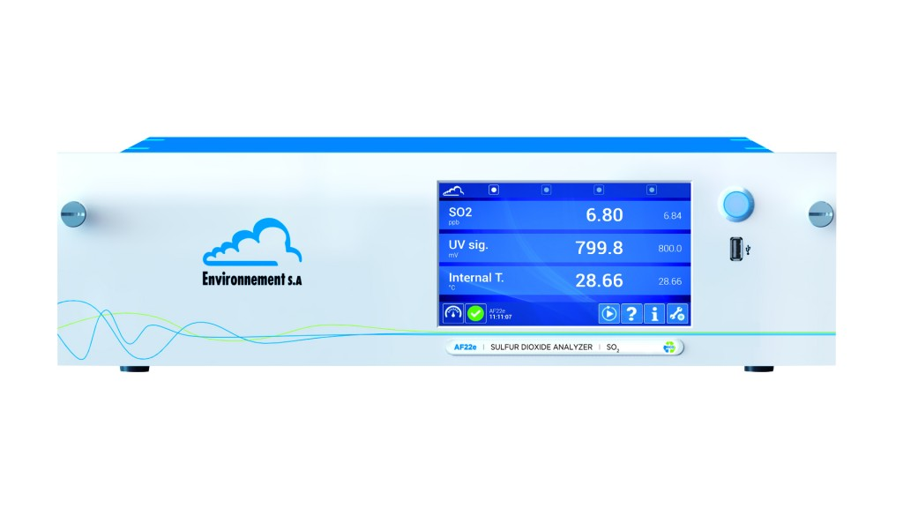
9.2 REFERENCE AND EQUIVALENT METHODS
European Union IPA 2013 Programme for Croatia
HRN EN 14212:2012
EQUIPMENT
ENVIRONNEMENT
– AF 22
Institut za energetiku i zaštitu okoliša
Energy Research and Environmental Protection Institute

Slide 90

9.2 REFERENCE AND EQUIVALENT METHODS
European Union IPA 2013 Programme for Croatia
HRN EN 14212:2012
Ambient air – Standard method for the measurement of the concentration of sulphur dioxide by ultraviolet fluorescence
This standard has a correction:
HRN EN 14212:2012/Cor.1:2014 (EN 14212:2012/AC:2014)
This European standard establishes a method for continuous measurement for determination of concentrations of sulphur dioxide in the ambient air on the measurement principle of ultraviolet fluorescence.
EQUIVALENT METHOD
Hydrogen sulphide is converted into sulphur dioxide which determination is based on the principle of UV fluorescence.
Institut za energetiku i zaštitu okoliša
Energy Research and Environmental Protection Institute

Slide 91
9.2 REFERENCE AND EQUIVALENT METHODS
European Union IPA 2013 Programme for Croatia
HRN EN 14212:2012 (H2S)
When entering the analyzer, the air is filtered and passes the scrabber of sulphur dioxide that completely adsorbs SO₂ from the sampled air, which is necessary to avoid SO₂ measurement which would then be displayed as H₂S. Then the air passes through a converter in which hydrogen sulphide is oxidized to sulphur dioxide in moles per mol. After this procedure, further measurement is identical to measurement of SO₂.
Before entering the reaction chamber, the air is filtered and passed through a hydrocarbon scrabber that would otherwise cause interference. Then the air enters the reaction chamber where it is, under standardized conditions, exposed to UV rays in the wavelength area between 200 and 220 nm.
When returning from excited to the normal state, the SO₂ molecules emit radiation in the range of wavelengths between 240 and 420 nm. This emission is, by using selective optical filters, transformed into an electric signal by a photoconductor or a photodiode. The electrical signal is measured and its intensity is proportional to the number of molecules, i.e. at standardized conditions of SO₂ concentration which entered the reaction.
Institut za energetiku i zaštitu okoliša
Energy Research and Environmental Protection Institute

Slide 92
9.2 REFERENCE AND EQUIVALENT METHODS
European Union IPA 2013 Programme for Croatia
HRN EN 14212:2012 (H2S)
Concentrations of SO₂ are measured directly into volume/volume units (ppb) since the absorption in the IR spectrum is proportional to the concentration of SO₂ in volume/volume units. After obtaining concentration in ppb values, the result is converted to μg/m³ using standard conversion factors for a temperature of 20 °C and a pressure of 101.3 kPa whereat :
1 ppb (nmol/mol) SO₂ (H₂S) = 1,41 µg/m³ H₂S
Institut za energetiku i zaštitu okoliša
Energy Research and Environmental Protection Institute

Slide 93
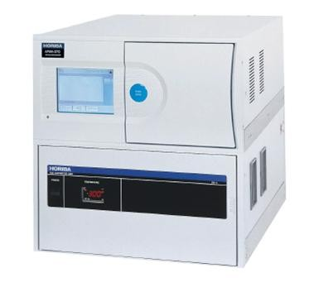
9.2 REFERENCE AND EQUIVALENT METHODS
European Union IPA 2013 Programme for Croatia
HRN EN 14212:2012
EQUIPMENT
HORIBA
– APSA 370 + CU
Institut za energetiku i zaštitu okoliša
Energy Research and Environmental Protection Institute

Slide 94
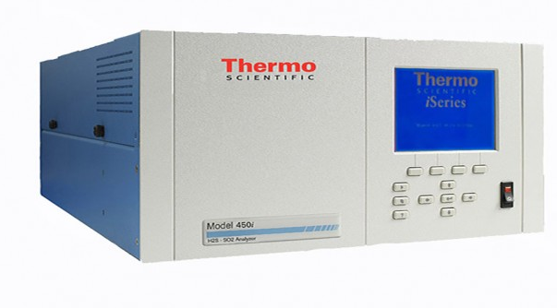
9.2 REFERENCE AND EQUIVALENT METHODS
European Union IPA 2013 Programme for Croatia
HRN EN 14212:2012
EQUIPMENT
THERMO SCIENTIFIC
– MODEL 450i
Institut za energetiku i zaštitu okoliša
Energy Research and Environmental Protection Institute

Slide 95
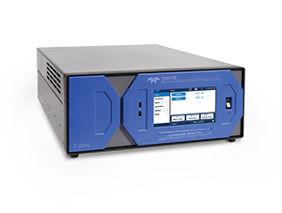
9.2 REFERENCE AND EQUIVALENT METHODS
European Union IPA 2013 Programme for Croatia
HRN EN 14212:2012
EQUIPMENT
TELEDYNE
– API T101E
Institut za energetiku i zaštitu okoliša
Energy Research and Environmental Protection Institute

Slide 96

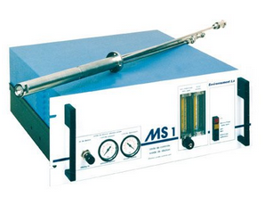
9.2 REFERENCE AND EQUIVALENT METHODS
European Union IPA 2013 Programme for Croatia
HRN EN 14212:2012
EQUIPMENT
ENVIRONNEMENT
– AF 22
Institut za energetiku i zaštitu okoliša
Energy Research and Environmental Protection Institute

Slide 97

9.2 REFERENCE AND EQUIVALENT METHODS
European Union IPA 2013 Programme for Croatia
HRN EN 14211:2012
Ambient air - Standard method for the measurement of the concentration of nitrogen dioxide and nitrogen monoxide by chemiluminescence
This European standard establishes a method for continuous measurement for determination of concentration of nitrogen dioxide and nitrogen monoxide in the ambient air at the chemiluminescence principle.
The standard describes the performance characteristics and sets the minimum criteria required for selecting the appropriate analyzer.
It also includes an assessment of the suitability of the analyzer for use on the meter station to meet the data quality requirements in accordance with the Directive 2008/50/EC.
Institut za energetiku i zaštitu okoliša
Energy Research and Environmental Protection Institute

Slide 98
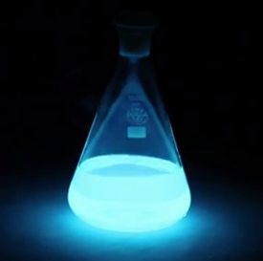
9.2 REFERENCE AND EQUIVALENT METHODS
European Union IPA 2013 Programme for Croatia
HRN EN 14211:2012
MEASUREMENT AREA
NO₂ 0 - 500 µg/m³ (0 - 261 nmol/mol)
NO 0 - 1200 µg/m³ (0 - 962 nmol/mol)
MEASUREMENT PRINCIPLE
CHEMILUMINESCENCE
Institut za energetiku i zaštitu okoliša
Energy Research and Environmental Protection Institute

Slide 99
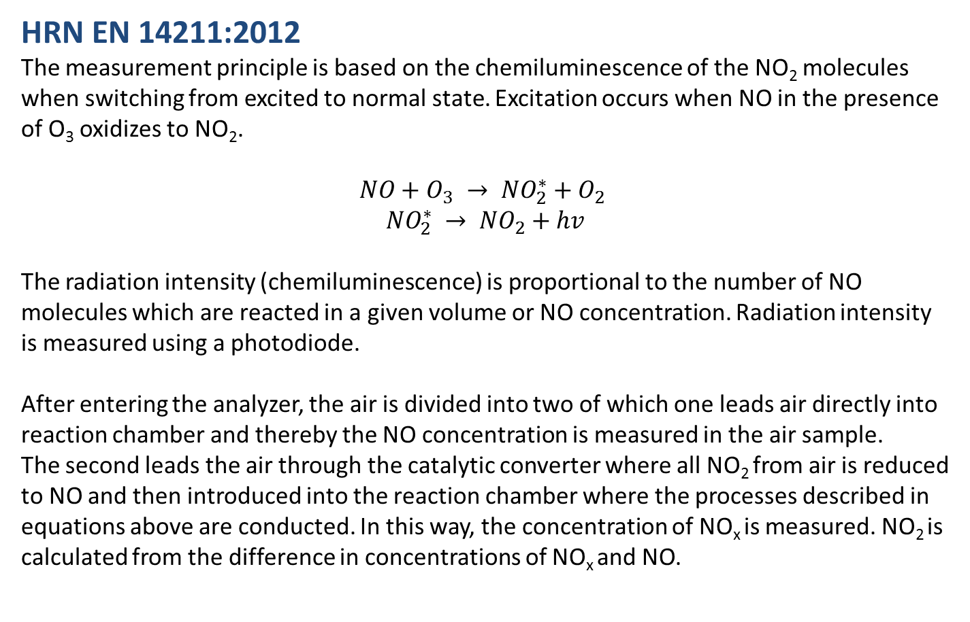
9.2 REFERENCE AND EQUIVALENT METHODS
European Union IPA 2013 Programme for Croatia
HRN EN 14211:2012
The measurement principle is based on the chemiluminescence of the NO₂ molecules when switching from excited to normal state. Excitation occurs when NO in the presence of O₃ oxidizes to NO₂.
$$NO+O_{3} → {NO}_{2}^{∗}+O_{2}$$
$${NO}_{2}^{∗} → {NO}_{2}+hv$$
The radiation intensity (chemiluminescence) is proportional to the number of NO molecules which are reacted in a given volume or NO concentration. Radiation intensity is measured using a photodiode.
After entering the analyzer, the air is divided into two of which one leads air directly into reaction chamber and thereby the NO concentration is measured in the air sample.
The second leads the air through the catalytic converter where all NO₂ from air is reduced to NO and then introduced into the reaction chamber where the processes described in equations above are conducted. In this way, the concentration of NO_{x} is measured. NO₂ is calculated from the difference in concentrations of NO_{x} and NO.
Institut za energetiku i zaštitu okoliša
Energy Research and Environmental Protection Institute

Slide 100
9.2 REFERENCE AND EQUIVALENT METHODS
European Union IPA 2013 Programme for Croatia
HRN EN 14211:2012
NO₂ concentrations are measured directly in volume/volume units (ppb) if the calibration is carried out with a 'vol/vol' ethalon. After obtaining concentration in ppb the result is converted to μg/m³ using standard conversion factors for temperature 20 ° C and a pressure of 101.3 kPa.
1 ppb (nmol/mol) NO₂ = 1,91 µg/m³ NO₂
1 ppb (nmol/mol) NO = 1,25 µg/m³ NO
Institut za energetiku i zaštitu okoliša
Energy Research and Environmental Protection Institute

Slide 101
9.2 REFERENCE AND EQUIVALENT METHODS
European Union IPA 2013 Programme for Croatia
HRN EN 14211:2012
Institut za energetiku i zaštitu okoliša
Energy Research and Environmental Protection Institute

Slide 102
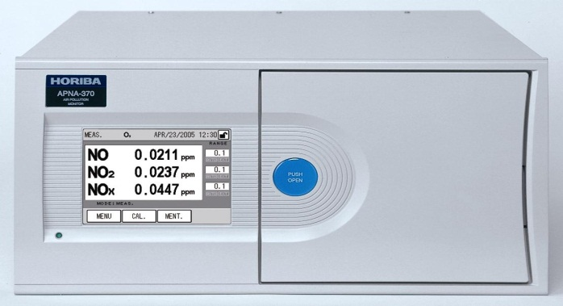
9.2 REFERENCE AND EQUIVALENT METHODS
European Union IPA 2013 Programme for Croatia
HRN EN 14211:2012
EQUIPMENT
HORIBA – APNA 370
Institut za energetiku i zaštitu okoliša
Energy Research and Environmental Protection Institute

Slide 103

9.2 REFERENCE AND EQUIVALENT METHODS
European Union IPA 2013 Programme for Croatia
HRN EN 14211:2012
EQUIPMENT
THERMO SCIENTIFIC
– MODEL 42i
Institut za energetiku i zaštitu okoliša
Energy Research and Environmental Protection Institute

Slide 104
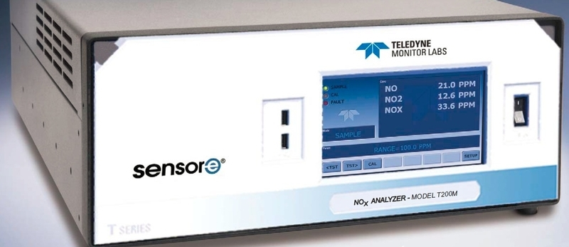
9.2 REFERENCE AND EQUIVALENT METHODS
European Union IPA 2013 Programme for Croatia
HRN EN 14211:2012
EQUIPMENT
TELEDYNE
– API T200
Institut za energetiku i zaštitu okoliša
Energy Research and Environmental Protection Institute

Slide 105

9.2 REFERENCE AND EQUIVALENT METHODS
European Union IPA 2013 Programme for Croatia
HRN EN 14211:2012
EQUIPMENT
ENVIRONNEMENT
– ACM 32
Institut za energetiku i zaštitu okoliša
Energy Research and Environmental Protection Institute

Slide 106
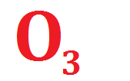
9.2 REFERENCE AND EQUIVALENT METHODS
European Union IPA 2013 Programme for Croatia
HRN EN 14625:2012
Ambient air – Standard method for the measurement of the concentration of ozone by ultraviolet photometry
This European Standard establishes a method for continuous measurement for determination of concentrations of ozone in the ambient air by ultraviolet photometry.
The standard describes the performance characteristics and sets the minimum criteria required for selecting the appropriate analyzer.
It also includes an assessment of the suitability of the analyzer for use on the meter station to meet the data quality requirements in accordance with the Directive 2008/50/EC.
Institut za energetiku i zaštitu okoliša
Energy Research and Environmental Protection Institute

Slide 107
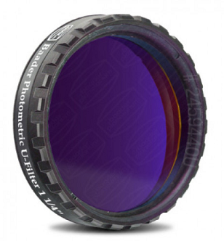
9.2 REFERENCE AND EQUIVALENT METHODS
European Union IPA 2013 Programme for Croatia
HRN EN 14625:2012
MEASUREMENT AREA
0 - 500 µg/m³
(0 – 250 nmol/mol)
MEASUREMENT PRINCIPLE
UV PHOTOMETRY
Institut za energetiku i zaštitu okoliša
Energy Research and Environmental Protection Institute

Slide 108
9.2 REFERENCE AND EQUIVALENT METHODS
European Union IPA 2013 Programme for Croatia
HRN EN 14625:2012
The method is based on the ability of ozone to absorb UV radiation.
Sampled air is filtered at the inlet into the analyzer, and with constant and known flow flows to the reaction cell in which the conditions of constant pressure and temperature are maintained. In that conditions the air is exposed to constant radiation of low pressure mercury lamps with peak values of 253.7 nm. Sensitive photodiodes or photomultiplier detectors measure the intensity of the radiation which passed through the reaction cell. Ozone in the air sample absorbs a certain amount of radiation that is at constant conditions in proportion to the concentration of ozone in the sample.
There are two basic ways of quantifying this absorption. One is to get through the same reaction cell the alternating air and ozone-free air sample, and the other is that there are two identical cells, and through one there is a continuous passage of air sample, and through the other the air without ozone. In both modes, ozone-free air is obtained by catalytically conducting air ozone convector. The difference in radiation intensity measured in the air with or without ozone, represents the absorption of radiation. Sampling of air containing a known concentration of ozone the analyzer is tuned, and it is possible to calculate the absorption from the calibration direction ozone concentration.
Institut za energetiku i zaštitu okoliša
Energy Research and Environmental Protection Institute

Slide 109
9.2 REFERENCE AND EQUIVALENT METHODS
European Union IPA 2013 Programme for Croatia
HRN EN 14625:2012
Institut za energetiku i zaštitu okoliša
Energy Research and Environmental Protection Institute

Slide 110
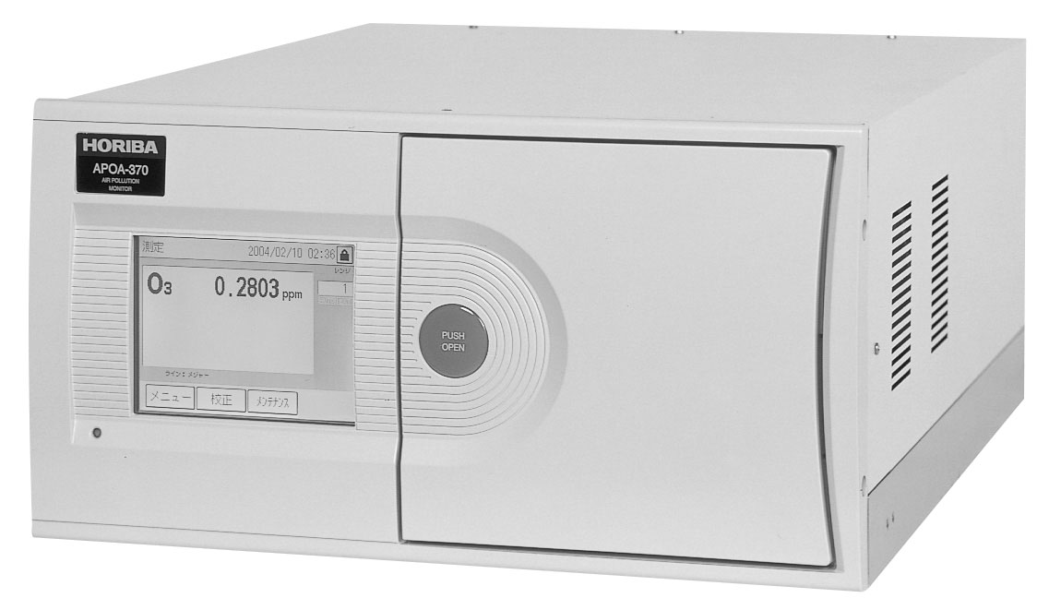
9.2 REFERENCE AND EQUIVALENT METHODS
European Union IPA 2013 Programme for Croatia
HRN EN 14625:2012
EQUIPMENT
HORIBA – APOA 370
Institut za energetiku i zaštitu okoliša
Energy Research and Environmental Protection Institute

Slide 111
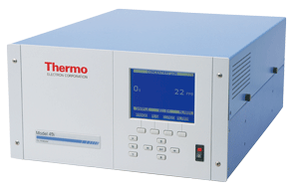
9.2 REFERENCE AND EQUIVALENT METHODS
European Union IPA 2013 Programme for Croatia
HRN EN 14625:2012
EQUIPMENT
THERMO SCIENTIFIC
– MODEL 49i
Institut za energetiku i zaštitu okoliša
Energy Research and Environmental Protection Institute

Slide 112
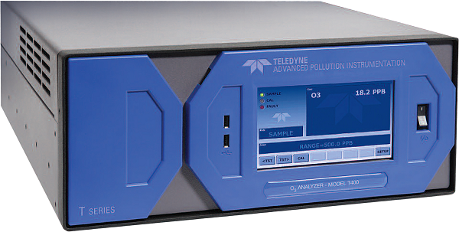
9.2 REFERENCE AND EQUIVALENT METHODS
European Union IPA 2013 Programme for Croatia
HRN EN 14625:2012
EQUIPMENT
TELEDYNE
– API T400
Institut za energetiku i zaštitu okoliša
Energy Research and Environmental Protection Institute

Slide 113

9.2 REFERENCE AND EQUIVALENT METHODS
European Union IPA 2013 Programme for Croatia
HRN EN 14625:2012
EQUIPMENT
ENVIRONNEMENT
– O342
Institut za energetiku i zaštitu okoliša
Energy Research and Environmental Protection Institute

Slide 114

9.2 REFERENCE AND EQUIVALENT METHODS
European Union IPA 2013 Programme for Croatia
HRN EN 14626:2012
Ambient air – Standard method for the measurement of the concentration of carbon monoxide by non-dispersive infrared spectroscopy
This European standard establishes a method for continuous measurement for determination of concentrations of carbon monoxide in the ambient air on the measurement principle of non-dispersive infrared spectroscopy.
The standard describes the performance characteristics and sets the minimum criteria required for selecting the appropriate analyzer.
It also includes an assessment of the suitability of the analyzer for use on the meter station to meet the data quality requirements in accordance with the Directive 2008/50/EC.
Institut za energetiku i zaštitu okoliša
Energy Research and Environmental Protection Institute

Slide 115
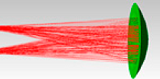
9.2 REFERENCE AND EQUIVALENT METHODS
European Union IPA 2013 Programme for Croatia
HRN EN 14626:2012
MEASUREMENT AREA
0 - 100 mg/m³
(0 – 86 μmol/mol)
MEASUREMENT PRINCIPLE
NON-DISPERSIVE INFRARED SPECTROSCOPY
Institut za energetiku i zaštitu okoliša
Energy Research and Environmental Protection Institute

Slide 116
9.2 REFERENCE AND EQUIVALENT METHODS
European Union IPA 2013 Programme for Croatia
HRN EN 14626:2012
The measurement principle is based on non-dispersive infrared spectroscopy since CO molecules have the ability to absorb infrared radiation. Spectroscopic analysis is based on applying the Beer - Lambert law. CO has the highest absorption at 4.67 μm and the absorption degree of IR radiation depends on the length of the absorption chamber, the absorption coefficient and CO concentration in the sample introduced into the absorption chamber according to the following equation:
T= I/I_{o}=e^{(-axc)}
where:
T - radiation transmission through the sample to detector
I - radiation intensity after absorption in the CO sample
I_{o} - radiation intensity after passing through the sample without CO
a - molar absorption coefficient of CO
x - length of the absorption chamber
c - concentration of CO
Interferences from other gases that absorb at close wavelengths are removed using a gas filter called the correlation wheel.
Institut za energetiku i zaštitu okoliša
Energy Research and Environmental Protection Institute

Slide 117
9.2 REFERENCE AND EQUIVALENT METHODS
European Union IPA 2013 Programme for Croatia
HRN EN 14626:2012
Institut za energetiku i zaštitu okoliša
Energy Research and Environmental Protection Institute

Slide 118
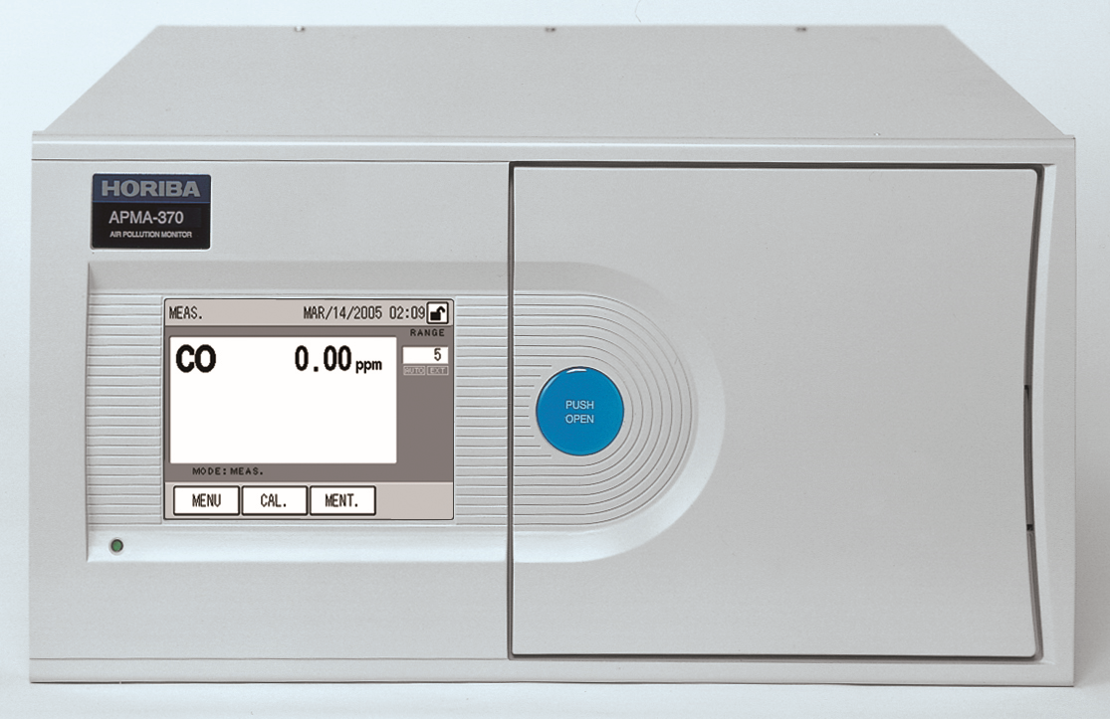
9.2 REFERENCE AND EQUIVALENT METHODS
European Union IPA 2013 Programme for Croatia
HRN EN 14626:2012
EQUIPMENT
HORIBA – APMA 370
Institut za energetiku i zaštitu okoliša
Energy Research and Environmental Protection Institute

Slide 119

9.2 REFERENCE AND EQUIVALENT METHODS
European Union IPA 2013 Programme for Croatia
HRN EN 14626:2012
EQUIPMENT
THERMO SCIENTIFIC
– MODEL 48i
Institut za energetiku i zaštitu okoliša
Energy Research and Environmental Protection Institute

Slide 120
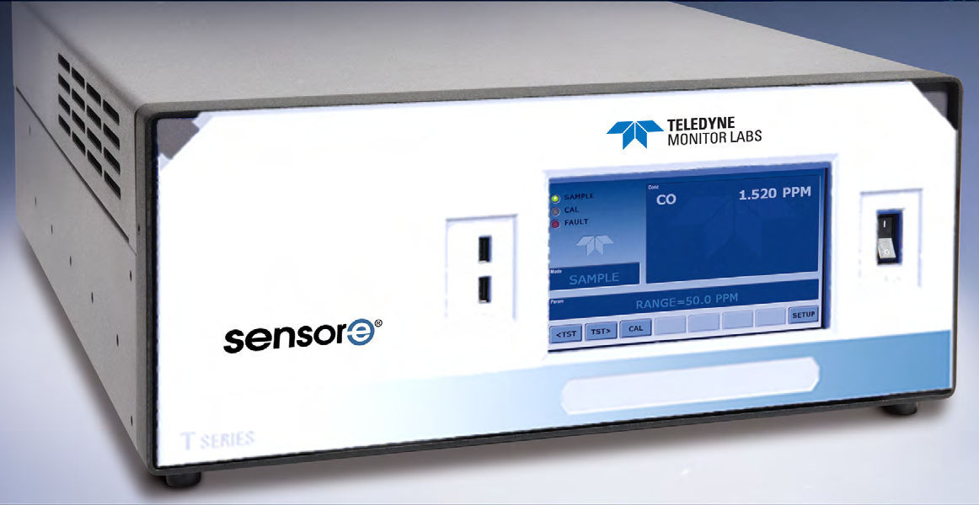
9.2 REFERENCE AND EQUIVALENT METHODS
European Union IPA 2013 Programme for Croatia
HRN EN 14626:2012
EQUIPMENT
TELEDYNE
– API T300
Institut za energetiku i zaštitu okoliša
Energy Research and Environmental Protection Institute

Slide 121
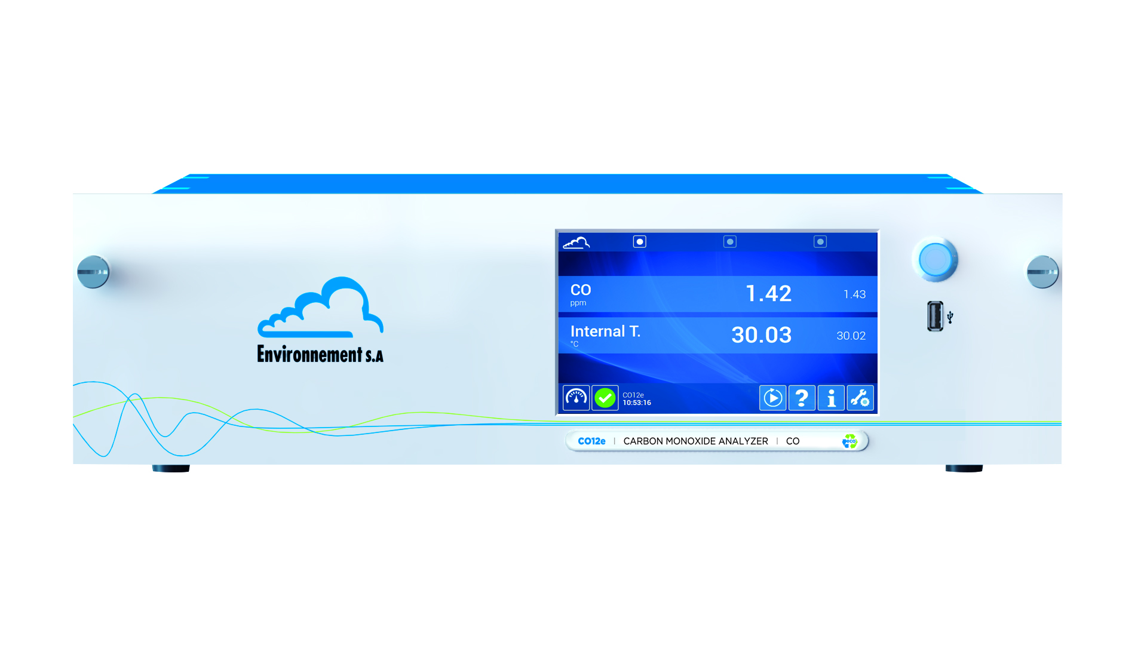
9.2 REFERENCE AND EQUIVALENT METHODS
European Union IPA 2013 Programme for Croatia
HRN EN 14626:2012
EQUIPMENT
ENVIRONNEMENT
– CO 12
Institut za energetiku i zaštitu okoliša
Energy Research and Environmental Protection Institute

Slide 122

9.2 REFERENCE AND EQUIVALENT METHODS
European Union IPA 2013 Programme for Croatia
HRN EN 14626:2012
Ambient air – Standard method for measurement of benzene concentrations – Part 3: Automated pumped sampling with in situ gas chromatography
This European standard establishes a method for continuous measurement for determination of concentrations of benzene in the ambient air based on automated sampling by gas chromatography.
The standard describes the performance characteristics and sets the minimum criteria required for selecting the appropriate analyzer.
It also includes an assessment of the suitability of the analyzer for use on the meter station to meet the data quality requirements in accordance with the Directive 2008/50/EC.
Institut za energetiku i zaštitu okoliša
Energy Research and Environmental Protection Institute

Slide 123
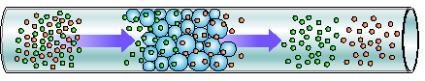
9.2 REFERENCE AND EQUIVALENT METHODS
European Union IPA 2013 Programme for Croatia
HRN EN 14626:2012
MEASUREMENT AREA
0 - 50 µg/m³
(0 – 15,4 nmol/mol)
MEASUREMENT PRINCIPLE
GAS CROMATOGRAPHY
Institut za energetiku i zaštitu okoliša
Energy Research and Environmental Protection Institute

Slide 124
9.2 REFERENCE AND EQUIVALENT METHODS
European Union IPA 2013 Programme for Croatia
HRN EN 14626:2012
The metering principle for benzene measurement involves sampling by diluting with heat desorption and simultaneous analysis by gas chromatography.
The method according to HRN EN 14662-3 is based on classical gas chromatography and detection using a flame (FID) or photoionisation (PID) detector. Also, it is allowed to use and any other suitable detector.
Measured air volume is pumped by using a pump on the adsorption pre - column which binds the benzene from the sample, and the air without benzene exits the analyzer. Thereafter by heating the benzene vapor free from the adsorbent and by using inert gas (most often nitrogen of high purity) are transferred to a chromatographic column where separation of benzene occurs from other easily volatile hydrocarbons (xylene, toluene). Benzene injected with inert gas after passing through the column at exactly the same time as retention time (for the same chemical compound, same system and same conditions, retention time is always the same) enters the detector that registers the passage of benzene to the proportional mass of benzene.
Institut za energetiku i zaštitu okoliša
Energy Research and Environmental Protection Institute

Slide 125
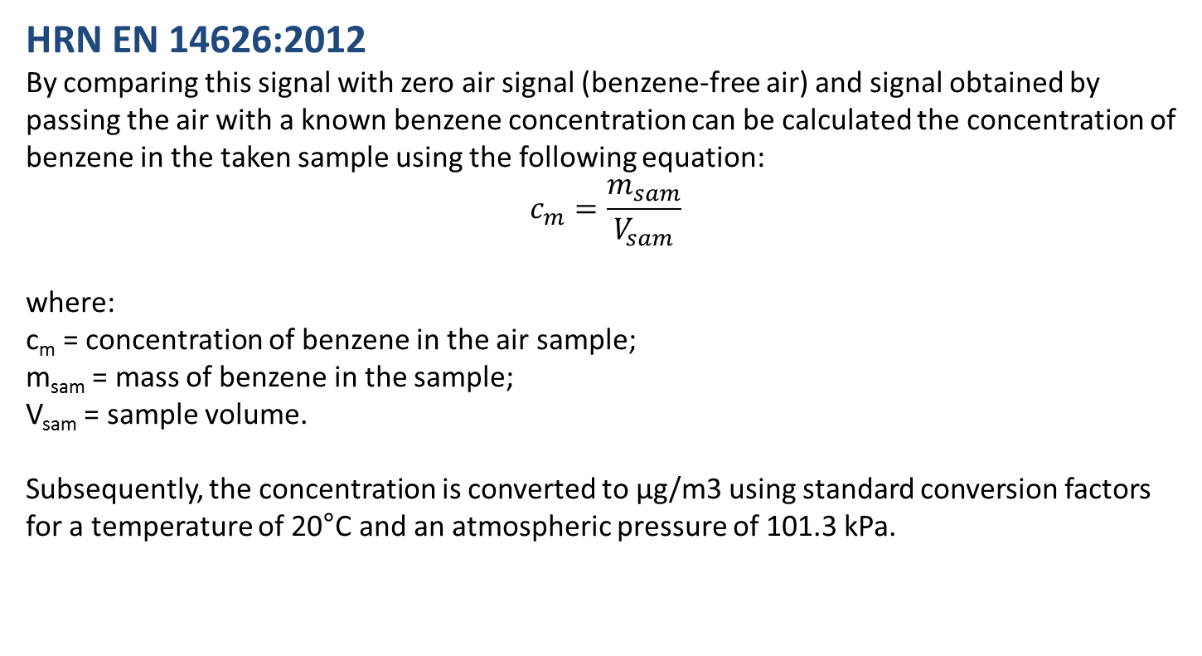
9.2 REFERENCE AND EQUIVALENT METHODS
European Union IPA 2013 Programme for Croatia
HRN EN 14626:2012
By comparing this signal with zero air signal (benzene-free air) and signal obtained by passing the air with a known benzene concentration can be calculated the concentration of benzene in the taken sample using the following equation:
$$c_{m}=\frac{m_{sam}}{V_{sam}}$$
where:
c_{m} = concentration of benzene in the air sample;
m_{sam} = mass of benzene in the sample;
V_{sam} = sample volume.
Subsequently, the concentration is converted to μg/m3 using standard conversion factors for a temperature of 20°C and an atmospheric pressure of 101.3 kPa.
Institut za energetiku i zaštitu okoliša
Energy Research and Environmental Protection Institute

Slide 126
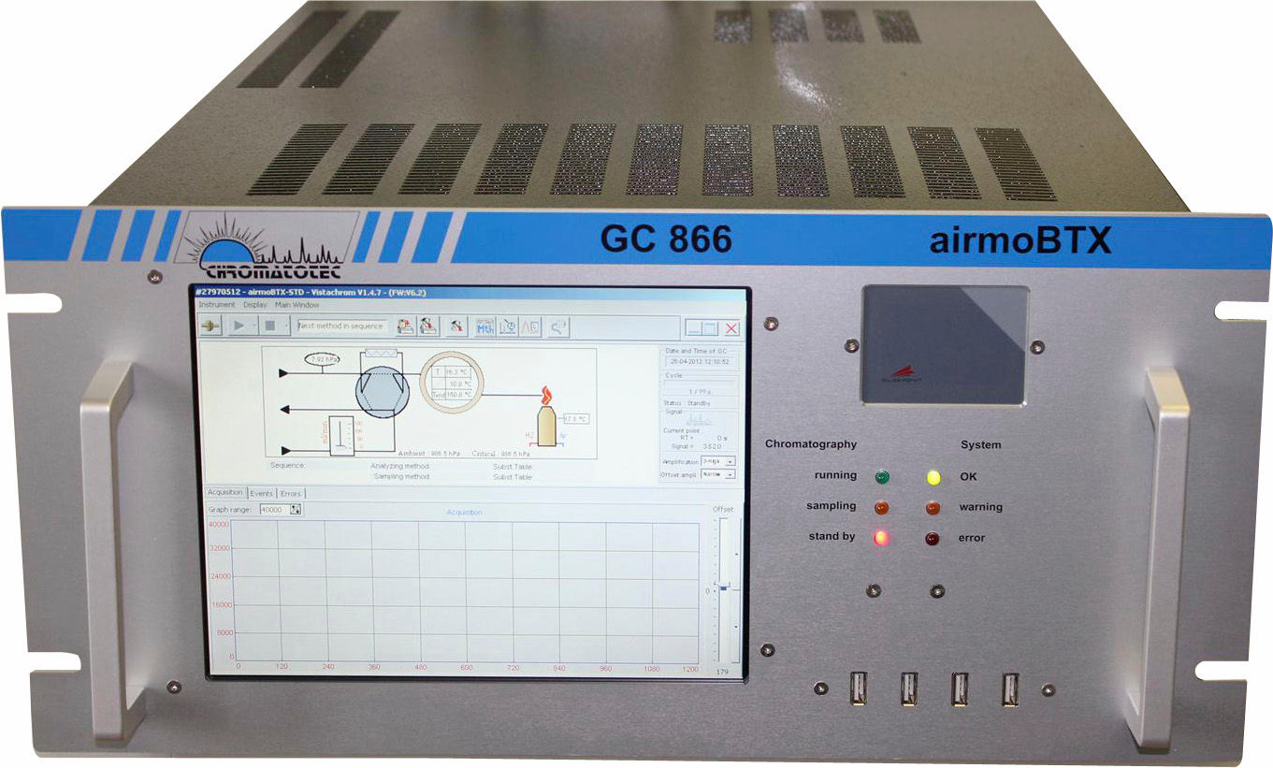
9.2 REFERENCE AND EQUIVALENT METHODS
European Union IPA 2013 Programme for Croatia
HRN EN 14626:2012
EQUIPMENT
CHROMATOTEC
– GC 866
Institut za energetiku i zaštitu okoliša
Energy Research and Environmental Protection Institute

Slide 127
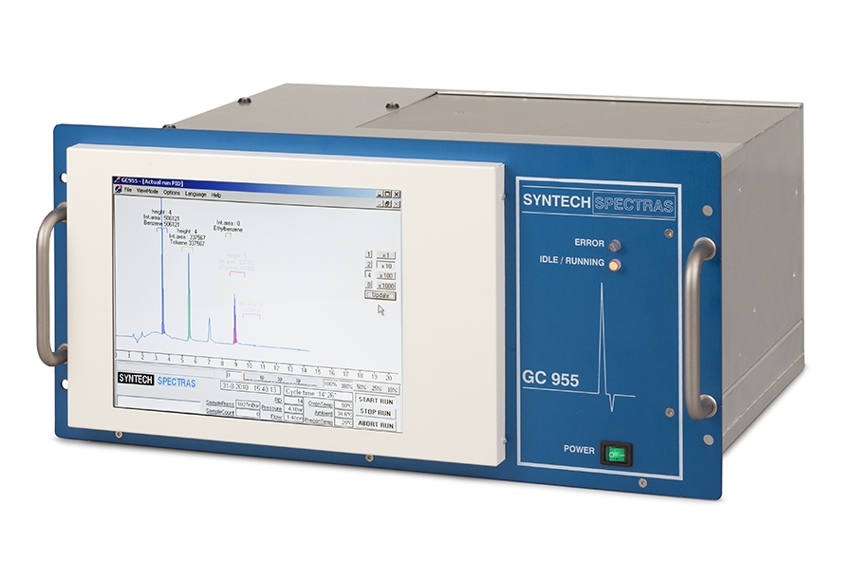
9.2 REFERENCE AND EQUIVALENT METHODS
European Union IPA 2013 Programme for Croatia
HRN EN 14626:2012
EQUIPMENT
SYNTECH
– GC 955
Institut za energetiku i zaštitu okoliša
Energy Research and Environmental Protection Institute

Slide 128
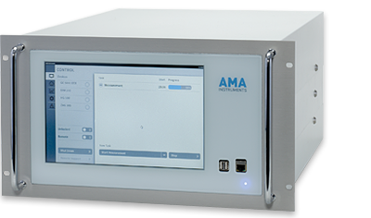
9.2 REFERENCE AND EQUIVALENT METHODS
European Union IPA 2013 Programme for Croatia
HRN EN 14626:2012
EQUIPMENT
AMA INSTRUMENTS
– GC 5000
Institut za energetiku i zaštitu okoliša
Energy Research and Environmental Protection Institute

Slide 129
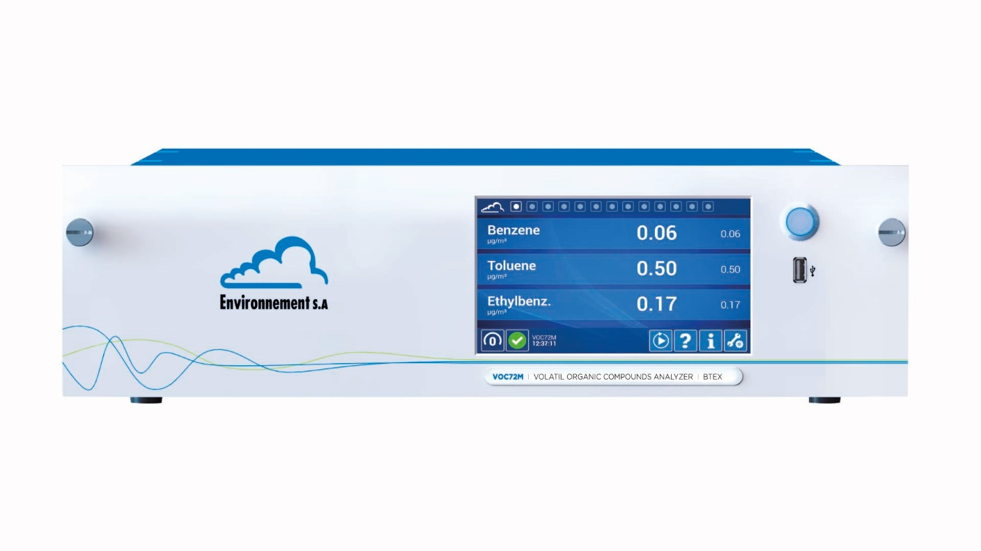
9.2 REFERENCE AND EQUIVALENT METHODS
European Union IPA 2013 Programme for Croatia
HRN EN 14626:2012
EQUIPMENT
ENVIRONMENT
– VOC 72
Institut za energetiku i zaštitu okoliša
Energy Research and Environmental Protection Institute

Slide 130
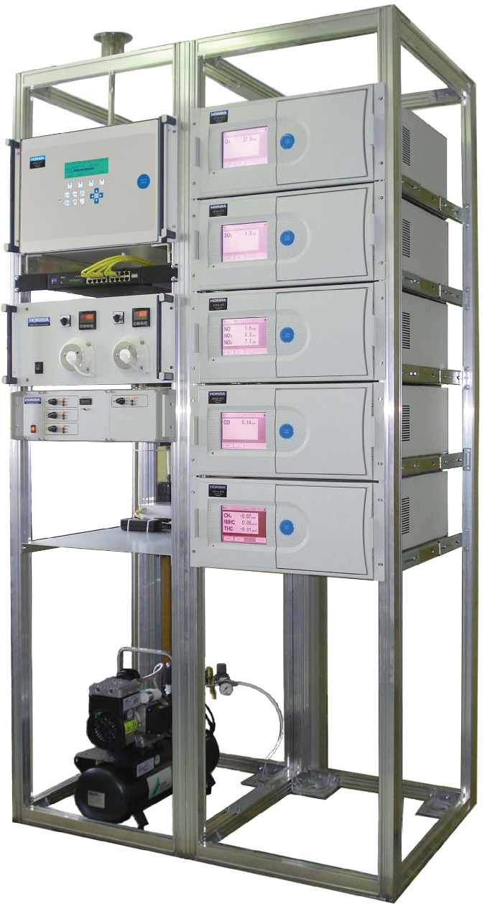
9.2 REFERENCE AND EQUIVALENT METHODS
European Union IPA 2013 Programme for Croatia
MEASUREMENT SYSTEM
The measurement system consists of:
• Gas analyzers
• Null and Range Response Check System
• Sampling system
• Thermostated isothermal stations
• Data transfer and data collection systems
Institut za energetiku i zaštitu okoliša
Energy Research and Environmental Protection Institute

Slide 131
9.2 REFERENCE AND EQUIVALENT METHODS
European Union IPA 2013 Programme for Croatia
MEASUREMENT SYSTEM
GAS ANALYZERS
Gas analyzers serve to measure concentrations of individual gases.
Before they are placed in the isothermal shelter (measuring station) they must be calibrated as well check the operating characteristics.
After setting up the station, the response to the zero position and position of the range with the analyzer response tester on the zero and the range at the station are checked.
Institut za energetiku i zaštitu okoliša
Energy Research and Environmental Protection Institute

Slide 132
9.2 REFERENCE AND EQUIVALENT METHODS
European Union IPA 2013 Programme for Croatia
MEASUREMENT SYSTEM
ZERO AND SPAN RESPONSE SYSTEM
The system consists of the following components:
• Dilution unit
• Certified reference gas (gas mixture)
• Zero gas generator
The system enables automatic checking of the response to zero and span for the purpose of measuring quality control as well as long-term monitoring of analyzer deviation.
Mixing of zero gas and certified reference gas a desired gas concentration is obtained by which the analyzer span is checked.
The dilution unit is supplied with zero gas from the gas generator and reference gas from a certified gas mixture.
Institut za energetiku i zaštitu okoliša
Energy Research and Environmental Protection Institute

Slide 133
9.2 REFERENCE AND EQUIVALENT METHODS
European Union IPA 2013 Programme for Croatia
MEASUREMENT SYSTEM
ZERO AND SPAN RESPONSE SYSTEM
The dilution unit is supplied with zero gas from the gas generator and reference gas from a certified gas mixture.
Institut za energetiku i zaštitu okoliša
Energy Research and Environmental Protection Institute

Slide 134
9.2 REFERENCE AND EQUIVALENT METHODS
European Union IPA 2013 Programme for Croatia
MEASUREMENT SYSTEM
SAMPLING SYSTEM
The sampling system consists of steel (inox) head and sample tube designed so that they prevent getting wet, both in the system and in the station interior. Through the tube of the sampler, the tube of silicone glass is passed which binds to the sample separator in the station which is also of the boron of silicate glass.
At the end of the system there is a sampler fan that ensures a constant sample flow with negligible difference in the pressures between the station and manifold. The system is constructed so that the sampled air comes into contact with only silicate boron glass and to ensure constant flow and air pressure in the manifold from which the instruments take the sample.
Institut za energetiku i zaštitu okoliša
Energy Research and Environmental Protection Institute

Slide 135
9.2 REFERENCE AND EQUIVALENT METHODS
European Union IPA 2013 Programme for Croatia
MEASUREMENT SYSTEM
SAMPLING SYSTEM
Institut za energetiku i zaštitu okoliša
Energy Research and Environmental Protection Institute

Slide 136
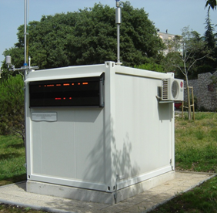
9.2 REFERENCE AND EQUIVALENT METHODS
European Union IPA 2013 Programme for Croatia
MEASUREMENT SYSTEM
THERMOSTATIC ISOTHERMAL STATION
Isothermal stations are designed to provide a constant temperature of 22 ° C ± 4 ° C and constant power supply of a stable voltage of 220V. Gas analyzers are located inside.
Institut za energetiku i zaštitu okoliša
Energy Research and Environmental Protection Institute

Slide 137
9.2 REFERENCE AND EQUIVALENT METHODS
European Union IPA 2013 Programme for Croatia
MEASUREMENT SYSTEM
DATA TRANSMISSION AND COLLECTION SYSTEM
The data transfer and data collection system enables correct receiving, storing, processing and transferring of data from instruments to the datalogger (or computer) and from datalogger to a supervisory computer in the Testing Laboratory.
Institut za energetiku i zaštitu okoliša
Energy Research and Environmental Protection Institute

Slide 138
9.2 REFERENCE AND EQUIVALENT METHODS
European Union IPA 2013 Programme for Croatia
Institut za energetiku i zaštitu okoliša
Energy Research and Environmental Protection Institute

Slide 139
9.3 EXAMPLES OF USING HRN EN STANDARDS
European Union IPA 2013 Programme for Croatia
SUITABILITY ASSESSMENT
A suitability assessment is performed to define the metering point, the conditions that exist at the metering point and how these conditions affect the operation of the gas analyzer.
The assessment is carried out for each individual measurement. Criteria to be assessed are defined in the standards :
HRN EN 14211:2012 – for NO/Nox measurement
HRN EN 14212:2012 – for SO2 and H2S measurement
HRN EN 14625:2012 – for O3 measurement
HRN EN 14626:2012 – for CO measurement
HRN EN 14662-3:2012 – for C6H6 measurement
Institut za energetiku i zaštitu okoliša
Energy Research and Environmental Protection Institute

Slide 140
9.3 EXAMPLES OF USING HRN EN STANDARDS
European Union IPA 2013 Programme for Croatia
SUITABILITY ASSESSMENT
Example of suitability assessment for CO measurement according to HRN EN 14626:2012
Variations in sample pressure:
- First, check the manifold
- impact of the pressure drop due to the sampler pump and the efficiency of sampling
- if the checks are satisfactory and the sampling system is "standard„ it is estimated that the maximum pressure variation throughout the year does not exceed that of the type approvals, so the component of the type approval is taken into account in the calculation of uncertainty
Institut za energetiku i zaštitu okoliša
Energy Research and Environmental Protection Institute

Slide 141
9.3 EXAMPLES OF USING HRN EN STANDARDS
European Union IPA 2013 Programme for Croatia
SUITABILITY ASSESSMENT
Variations in sample temperature:
- if the system for sampling, shelter and air conditioning are "standard„ it is estimated that the maximum variation of sample temperature over the year does not exceed the one from the type approval and then the component of the type approval is taken into account in the calculation of uncertainty
- temperature of sampled air is monitored throughout the year and after the first year, the results are corrected
- if the system for sampling, shelter and air conditioning are "standard„ it is estimated that the maximum variation of station temperature over the year does not exceed the one from the type approval and then the component of the type approval is taken into account in the calculation of uncertainty
- the station temperature is monitored throughout the year and after the first year, the results are corrected
Institut za energetiku i zaštitu okoliša
Energy Research and Environmental Protection Institute

Slide 142
9.3 EXAMPLES OF USING HRN EN STANDARDS
European Union IPA 2013 Programme for Croatia
SUITABILITY ASSESSMENT
Variations in the voltage of the power grid at the station :
- if the instrument is powered over the UPS, it is estimated that the maximum voltage variation in the station throughout the year does not exceed that of the type approval and so the component of type approval is taken in the calculation of the measurement uncertainty
- the voltage in station is monitored throughout the year and after the first year, the results are corrected
Range of H₂O concentration in the sample:
- if the system for sampling, shelter and air conditioning is "standard„ it is estimated that the maximum variation of moisture in the sample throughout the year does not exceed that from the type approval, so the calculation of uncertainty takes the component from type approval
Institut za energetiku i zaštitu okoliša
Energy Research and Environmental Protection Institute

Slide 143
9.3 EXAMPLES OF USING HRN EN STANDARDS
European Union IPA 2013 Programme for Croatia
SUITABILITY ASSESSMENT
Range of CO2 concentration in the sample:
- if it is a typical urban traffic station it is estimated that the maximum concentrations of CO2 do not exceed 500 μmol/mol so the calculation of uncertainty takes the component from type approval
Range of NO concentration in the sample:
- if it is a typical urban traffic station it is estimated that the maximum concentrations of NO do not exceed 1 μmol/mol so the calculation of uncertainty takes the component from type approval
Institut za energetiku i zaštitu okoliša
Energy Research and Environmental Protection Institute

Slide 144
9.3 EXAMPLES OF USING HRN EN STANDARDS
European Union IPA 2013 Programme for Croatia
SUITABILITY ASSESSMENT
Range of N2O concentration in the sample:
- if it is a typical urban traffic station it is estimated that the maximum concentrations of N2O do not exceed 50 nmol/mol so the calculation of uncertainty takes the component from type approval
Extended measurement uncertainty of calibration gas:
- it is calculated and included in the extended measurement uncertainty
Frequency of calibration and checking of analyzer response:
- it is calculated, and the response frequency is taken into account
Institut za energetiku i zaštitu okoliša
Energy Research and Environmental Protection Institute

Slide 145
9.3 EXAMPLES OF USING HRN EN STANDARDS
European Union IPA 2013 Programme for Croatia
INITIAL INSTALLATION
Initial procedures provide and prove that the type approved analyzer is in satisfactory condition, that it is mounted in the correct manner and in conditions that provide measurements that will satisfy the quality of the data provided by the regulations of the Republic of Croatia and EU.
Records of initial installation include:
1. reports on the suitability of individual analyzers
2. certificates of calibration of the analyzer
3. reports on test performance of the analyzer
4. analyzer installation logs
5. reports on the data receiving and collection system
Institut za energetiku i zaštitu okoliša
Energy Research and Environmental Protection Institute

Slide 146
9.3 EXAMPLES OF USING HRN EN STANDARDS
European Union IPA 2013 Programme for Croatia
RESULTS QUALITY ASSURANCE
Ensuring the quality of the test results includes the following elements:
- preventive maintenance
- quality control at the station
- calibration
- performance check
- corrective actions
- external quality control.
Institut za energetiku i zaštitu okoliša
Energy Research and Environmental Protection Institute

Slide 147
9.3 EXAMPLES OF USING HRN EN STANDARDS
European Union IPA 2013 Programme for Croatia
RESULTS QUALITY ASSURANCE
PREVENTIVE MAINTENANCE
Procedures for preventive maintenance of the analyzer include: checking of technical correctness, regular service inspection of the measuring station, regular maintenance of the system for sampling, regular maintenance of the air conditioning and fire alarm system and regular annual service.
Institut za energetiku i zaštitu okoliša
Energy Research and Environmental Protection Institute

Slide 148
9.3 EXAMPLES OF USING HRN EN STANDARDS
European Union IPA 2013 Programme for Croatia
RESULTS QUALITY ASSURANCE
PREVENTIVE MAINTENANCE
Procedure | Frequency of performance
Verification of technical validity of instruments | three times a week
Check the analyzer response on the measuring station | every 25 hours
Regular service inspection of the station | every 15 days
Regular maintenance of the sampling system | every 6 months or as required
Regular maintenance of air conditioning and fire alarm system | every 6 months or as required
Regular annual service of the analyzer | once a year
Institut za energetiku i zaštitu okoliša
Energy Research and Environmental Protection Institute

Slide 149
9.3 EXAMPLES OF USING HRN EN STANDARDS
European Union IPA 2013 Programme for Croatia
RESULTS QUALITY ASSURANCE
QUALITY CONTROL AT THE STATION
The quality control procedures at the station are used to control everyday operation of the measuring system. In this way, the functionality of the instruments is regularly maintained and it enables a timely reaction to possible irregularities in the instruments operation that might otherwise remain unnoticed for a long time.
If checking of the response to zero gas and gas range shows that the eligibility criteria are not satisfied, then the metrics are validated again for the period of the time when the respondents were last satisfied with the criteria.
Institut za energetiku i zaštitu okoliša
Energy Research and Environmental Protection Institute

Slide 150
9.3 EXAMPLES OF USING HRN EN STANDARDS
European Union IPA 2013 Programme for Croatia
RESULTS QUALITY ASSURANCE
CALIBRATION
Calibration is carried out in a calibration laboratory that can provide the measurement traceability according to HRN EN ISO/IEC 17025.
It is conducted:
after each annual service
in the case of passing the acceptance limits to check the zero position or position range
after major servicing procedures on the analyzer.
The calibration result is a Certificate or Calibration Certificate, and it is kept in the analyzer folder.
Institut za energetiku i zaštitu okoliša
Energy Research and Environmental Protection Institute

Slide 151
9.3 EXAMPLES OF USING HRN EN STANDARDS
European Union IPA 2013 Programme for Croatia
RESULTS QUALITY ASSURANCE
CALIBRATION
Institut za energetiku i zaštitu okoliša
Energy Research and Environmental Protection Institute

Slide 152
9.3 EXAMPLES OF USING HRN EN STANDARDS
European Union IPA 2013 Programme for Croatia
RESULTS QUALITY ASSURANCE
PERFORMANCE TEST
In addition to the calibration, a test of the performance of the analyzer is carried out which includes:
lack of fit
check the standard deviation of three-point and zero repeatability and
short-time check to zero and range
checking the efficiency of the converter (NO/NOx analyzers).
The analyzer must meet the values within the admissibility limits prescribed for each individual analyzer prescribed by the corresponding HRN EN standard.
The performance check is carried out once a year (usually during calibration).
Institut za energetiku i zaštitu okoliša
Energy Research and Environmental Protection Institute

Slide 153
9.3 EXAMPLES OF USING HRN EN STANDARDS
European Union IPA 2013 Programme for Croatia
RESULTS QUALITY ASSURANCE
Performance test - SO2 analyzers
Broj prema Tablici 6 ili 1 norme HRN EN 14212 Number according to Table 6 or 1 of the EN 14212 | Oznaka iz norme HRN EN 14212 Symbol according to EN 14212 | Karakteristika Characteristic | Rezultat provjere (nmol/mol ili %) Result of the check (nmol/mol or %) | Granice prihvatljivosti Acceptance limits | Sukladnost Compliance
Tablica 6/2a Table 6/2a | s_{r,z} | ponovljivost na nultom plinu repeatability at zero | 0,09 | < 1,0 nmol/mol | Zadovoljava Complies
Tablica 6/2b Table 6/2b | s_{r} | ponovljivost na rasponu (80% mjernog područja) repeatability at span (80% of measurement range) | 0,16% | < 1,5% | Zadovoljava Complies
Tablica 6/5b Table 6/5b | r_{max} | nelinearnost za točke različite od 0 lack of fit at concentrations higher than zero | 0,78% | < 4,0% | Zadovoljava Complies
Tablica 6/5a Table 6/5a | xl,z | nelinearnost na 0 lack of fit at zero | -0,73 | < 5,0 nmol/mol | Zadovoljava Complies
Tablica 1/13 Table 1/13 | Ds,z | kratkotrajni odmak na nultom plinu short-term drift at zero level | -0,40 | < 2,0 nmol/mol kroz 12 sati / over 12 hours | Zadovoljava Complies
Tablica 1/14 Table 1/14 | Ds,s | kratkotrajni odmak na rasponu short-term drift at span level | 1,65 | < 6,0 nmol/mol kroz 12 sati / over 12 hours | Zadovoljava Complies
Institut za energetiku i zaštitu okoliša
Energy Research and Environmental Protection Institute

Slide 154
9.3 EXAMPLES OF USING HRN EN STANDARDS
European Union IPA 2013 Programme for Croatia
RESULTS QUALITY ASSURANCE
Performance test - CO analyzers
Broj prema Tablici 6 ili 1 norme HRN EN 14626 Number according to Table 6 or 1 of the EN 14626 | Oznaka iz norme HRN EN 14626 Symbol according to EN 14626 | Karakteristika Characteristic | Rezultat provjere (µmol/mol ili %) Result of the check (µmol/mol or %) | Granice prihvatljivosti Acceptance limits | Sukladnost Compliance
Tablica 6/2a Table 6/2a | s_{r,z} | ponovljivost na nultom plinu repeatability at zero | 0,00 | < 0,5 µmol/mol | Zadovoljava Complies
Tablica 6/2b Table 6/2b | s_{r} | ponovljivost na rasponu (80% mjernog područja) repeatability at span (80% of measurement range) | 0,02% | < 3,0 % | Zadovoljava Complies
Tablica 6/5b Table 6/5b | r_{max} | nelinearnost za točke različite od 0 lack of fit at concentrations higher than zero | 0,36% | < 4,0% | Zadovoljava Complies
Tablica 6/5a Table 6/5a | xl,z | nelinearnost na 0 lack of fit at zero | 0,12 | < 0,5 µmol/mol | Zadovoljava Complies
Tablica 1/13 Table 1/13 | Ds,z | kratkotrajni odmak na nultom plinu short-term drift at zero level | 0,01 | < 0,1 µmol/mol kroz 12 sati / over 12 hours | Zadovoljava Complies
Tablica 1/14 Table 1/14 | Ds,s | kratkotrajni odmak na rasponu short-term drift at span level | 0,07 | < 0,6 µmol/mol kroz 12 sati / over 12 hours | Zadovoljava Complies
Institut za energetiku i zaštitu okoliša
Energy Research and Environmental Protection Institute

Slide 155
9.3 EXAMPLES OF USING HRN EN STANDARDS
European Union IPA 2013 Programme for Croatia
RESULTS QUALITY ASSURANCE
Performance test - NO/NOx analyzers
Broj prema Tablici 6 ili 1 norme HRN EN 14211 Number according to Table 6 or 1 of the EN 14211 | Oznaka iz norme HRN EN 14211 Symbol according to EN 14211 | Karakteristika Characteristic | Rezultat provjere (nmol/mol ili %) Result of the check (nmol/mol or %) | Granice prihvatljivosti Acceptance limits | Sukladnost Compliance
Tablica 6/2a Table 6/2a | s_{r,z} | ponovljivost na nultom plinu repeatability at zero | 0,76 | < 1,0 nmol/mol | Zadovoljava Complies
Tablica 6/2b Table 6/2b | s_{r} | ponovljivost na rasponu (80% mjernog područja) repeatability at span (80% of measurement range) | 0,04% | < 0,75% | Zadovoljava Complies
Tablica 6/5b Table 6/5b | r_{max} | nelinearnost za točke različite od 0 lack of fit at concentrations higher than zero | 0,97% | < 4,0% | Zadovoljava Complies
Tablica 6/5a Table 6/5a | xl,z | nelinearnost na 0 lack of fit at zero | -2,20 | < 5,0 nmol/mol | Zadovoljava Complies
Tablica 6/6 Table 6/6 | E_{c} | učinkovitost konvertera converter efficiency | 98,8% | > 95% | Zadovoljava Complies
Tablica 1/13 Table 1/13 | Ds,z | kratkotrajni odmak na nultom plinu short-term drift at zero level | -1,05 | < 2,0 nmol/mol kroz 12 sati / over 12 hours | Zadovoljava Complies
Tablica 1/14 Table 1/14 | Ds,s | kratkotrajni odmak na rasponu short-term drift at span level | 2,96 | < 6,0 nmol/mol kroz 12 sati / over 12 hours | Zadovoljava Complies
Institut za energetiku i zaštitu okoliša
Energy Research and Environmental Protection Institute

Slide 156
9.3 EXAMPLES OF USING HRN EN STANDARDS
European Union IPA 2013 Programme for Croatia
RESULTS QUALITY ASSURANCE
Performance test - O3 analyzers
Broj prema Tablici 6 ili 1 norme HRN EN 14625 Number according to Table 6 or 1 of the EN 14625 | Oznaka iz norme HRN EN 14625 Symbol according to EN 14625 | Karakteristika Characteristic | Rezultat provjere (nmol/mol ili %) Result of the check (nmol/mol or %) | Granice prihvatljivosti Acceptance limits | Sukladnost Compliance
Tablica 6/2a Table 6/2a | s_{r,z} | ponovljivost na nultom plinu repeatability at zero | 0,08 | < 1,5 nmol/mol | Zadovoljava Complies
Tablica 6/2b Table 6/2b | s_{r} | ponovljivost na rasponu (80% mjernog područja) repeatability at span (80% of measurement range) | 0,12% | < 2,0% | Zadovoljava Complies
Tablica 6/5b Table 6/5b | r_{max} | nelinearnost za točke različite od 0 lack of fit at concentrations higher than zero | 0,16% | < 4,0% | Zadovoljava Complies
Tablica 6/5a Table 6/5a | xl,z | nelinearnost na 0 lack of fit at zero | -0,06 | < 5,0 nmol/mol | Zadovoljava Complies
Tablica 1/13 Table 1/13 | Ds,z | kratkotrajni odmak na nultom plinu short-term drift at zero level | 0,55 | < 2,0 nmol/mol kroz 12 sati / over 12 hours | Zadovoljava Complies
Tablica 1/14 Table 1/14 | Ds,s | kratkotrajni odmak na rasponu short-term drift at span level | 2,61 | < 6,0 nmol/mol kroz 12 sati / over 12 hours | Zadovoljava Complies
Institut za energetiku i zaštitu okoliša
Energy Research and Environmental Protection Institute

Slide 157
9.3 EXAMPLES OF USING HRN EN STANDARDS
European Union IPA 2013 Programme for Croatia
RESULTS QUALITY ASSURANCE
Performance test - C6H6 analyzers
Tablica u normi HRN EN 14662-3 Table in the EN 14662-3 | Oznaka iz norme HRN EN 14662-3 Symbol according to EN 14662-3 | Karakteristika Characteristic | Rezultat provjere (μgm⁻³ ili %) Result of the check (μgm⁻³ or %) | Granice prihvatljivosti Acceptance limits | Sukladnost Compliance
9 | s_{r,ct} | ponovljivost na rasponu repeatability at span | 0,12 | < 0,25 μg/m³ | Zadovoljava Complies
9 | s_{rz} | ponovljivost na 10%-tnoj razini godišnje vrijednosti repeatability at at 10 % of the level of the annual limit | 0,06 | < 0,2 μg/m³ | Zadovoljava Complies
9 | r_{max} | nelinearnost, najveće odstupanje lack of fit, largest residual | 2,57% | < 5,0% | Zadovoljava Complies
formula (3) | l_{det} | granica detekcije detection limit | 0,06 | N/A
1 | D_{s,s} | kratkotrajni odmak na rasponu short term drift at span level | 0,01 | < 2 μg/m³ | Zadovoljava Complies
Institut za energetiku i zaštitu okoliša
Energy Research and Environmental Protection Institute

Slide 158
9.3 EXAMPLES OF USING HRN EN STANDARDS
European Union IPA 2013 Programme for Croatia
RESULTS QUALITY ASSURANCE
CORRECTIVE ACTIONS
In case of exceeding the limits of acceptability of working characteristics and other major problems with the tests, the analyzer is considered unsuitable for further measurements and it is provided for servicing.
After servicing, it is necessary to calibrate and check its operating characteristics.
If calibration and checking show that the analyzer is suitable for further measurement, it is returned to the measuring station.
If checking the response to zero gas and gas range shows that the eligibility criteria are not satisfied, then the metrics are validated again for the period of the time when the respondents were last satisfied with the criteria.
Institut za energetiku i zaštitu okoliša
Energy Research and Environmental Protection Institute

Slide 159
9.3 EXAMPLES OF USING HRN EN STANDARDS
European Union IPA 2013 Programme for Croatia
RESULTS QUALITY ASSURANCE
EXTERNAL QUALITY CONTROL
External quality control is performed by participating in ability testing schemes.
Ability Testing Schemes are organized by the organizer of Ability Testing in compliance with the requirements of international standard HRN EN ISO/IEC 17043.
Institut za energetiku i zaštitu okoliša
Energy Research and Environmental Protection Institute

Slide 160
9.3 EXAMPLES OF USING HRN EN STANDARDS
European Union IPA 2013 Programme for Croatia
MEASUREMENT UNCERTAINTY
Based on data from the type approval, calibration and measurement at the station the measurement uncertainty for the data from the reporting period is calculated and reported in annual report in the form of expanded measurement uncertainty.
Measurement uncertainties are calculated according to the following standards:
HRN EN 14211:2012 – for NO/NOx measurement
HRN EN 14212:2012 – for SO2 and H2S measurement
HRN EN 14625:2012 – for O3 measurement
HRN EN 14626:2012 – for CO measurement
HRN EN 14662-3:2012 – for C6H6 measurement
and document JCGM 100 (GUM method).
Institut za energetiku i zaštitu okoliša
Energy Research and Environmental Protection Institute

Slide 161
9.3 EXAMPLES OF USING HRN EN STANDARDS
European Union IPA 2013 Programme for Croatia
MEASUREMENT UNCERTAINTY
An example of a measurement uncertainty for CO measurements in accordance with HRN EN 14626:2012:
Measurement uncertainty is calculated in the form of extended measurement uncertainty for hourly averaging time at the limit value for the maximum daily 8-hour sliding average uc, absolute extended uncertainty for hourly averaging time at the limit value for 8-hour sliding average Uc and relative uncertainty Uc,rel.
Measurement uncertainty is calculated for a specific analyzer (e.g. HORIBA APMA 370 below) using the data from the type approval and the calibration certificate.
Institut za energetiku i zaštitu okoliša
Energy Research and Environmental Protection Institute

Slide 162
9.3 EXAMPLES OF USING HRN EN STANDARDS
European Union IPA 2013 Programme for Croatia
MEASUREMENT UNCERTAINTY
HRN EN 14626 | Code from standard | Component of measurement uncertainty | Results from | u (p) (µmol/mol) | u²(p)
1 | u_{r,z} | repeatibility at zero gas | Calibration certificates | x | y
2 | u_{r,lv} | repeatibility at limit value for 8h GV | Calibration certificates | x | y
3a | u_{l} | nonlinear analyzer (lack of fit test) for 8h GV | Calibration certificates | x | y
4 | u_{gp} | impact of pressure variability of sampled gas | Typ. approval Table 38 | 0,0120 | 0,0001
5 | u_{gt} | impact of temperature variability of sampled gas | Typ. approval Table 38 | 0,0240 | 0,0006
6 | u_{st} | impact of temperature variability of ambient air | Typ. approval Table 38 | -0,1823 | 0,0332
7 | u_{V} | impact of voltage variability of electricity | Typ. approval Table 38 | 0,0280 | 0,0008
8a | u_{H2O} | presence of water steam at limit value for 8h GV | Typ. approval Table 38 | 0,3261 | 0,1063
8b,c,d | u_{int} | interfering substances (positive int. – negative int.) | Typ. approval Table 38 | 0,4051 | 0,1641
Institut za energetiku i zaštitu okoliša
Energy Research and Environmental Protection Institute

Slide 163
9.3 EXAMPLES OF USING HRN EN STANDARDS
European Union IPA 2013 Programme for Croatia
MEASUREMENT UNCERTAINTY
9 | u_{av} | averaging effect | Typ. approval Table 38 | 0,0621 | 0,0039
10 | u_{r,f} | reproducibility | Typ. approval Table 38 | 0,0052 | 0,00003
11 | u_{d,l,z} | long-term shift to zero | Typ. approval Table 38 | 0,0993 | 0,0099
12 | u_{d,l,lv} | long-term shift to limit value for 8h GV | Typ. approval Table 38 | 0,0268 | 0,0007
21 | u_{cg} | calibration gas at 8h GV | Calibration certificates | x | y
Square of the assembled measurement uncertainty u² = ∑u²(p)
Compound measurement uncertainty at 8h GV u_{GV} = √u² (µmol/mol)
Expanded uncertainty at 8h GV U_{GV} = u*k (k=2) (µmol/mol)
Relative uncertainty at 8h GV U_{GV,rel} = (U_{GV}/8,6)*100 (%)
Relative uncertainty at 8h GV required by regulations (%) |  |  |  |  | 15
Institut za energetiku i zaštitu okoliša
Energy Research and Environmental Protection Institute

Slide 164
9.3 EXAMPLES OF USING HRN EN STANDARDS
European Union IPA 2013 Programme for Croatia
MAINTENANCE
HRN EN standards also describe and require maintenance, which includes:
particle filter changes (at least every 3 months)
modification of sampling lines (at least every 6 months)
Changes in consumables (according to manufacturer's requirements)
preventive/regular maintenance of parts of the analyzer (according to manufacturer's requirements)
Institut za energetiku i zaštitu okoliša
Energy Research and Environmental Protection Institute

Slide 165
9.4 TYPE APPROVAL OF ANALYZER
European Union IPA 2013 Programme for Croatia
TYPE APPROVAL
A type approval is a procedure which determines and confirms after the equipment testing is carried out, that this type of equipment complies with the conditions of relevant directives.
The type approval standard is the standard that provides the requirements which some type of equipment must meet to comply with the relevant directive.
This standard also defines which tests should be carried out to determine the value of the parameters being observed and evaluated.
Institut za energetiku i zaštitu okoliša
Energy Research and Environmental Protection Institute

Slide 166
9.4 TYPE APPROVAL OF ANALYZER
European Union IPA 2013 Programme for Croatia
Type approvals for individual analyzers are described in HRN EN standards:
HRN EN 14211:2012 – for NO/NOx analyzers
HRN EN 14212:2012 – for analyzers
HRN EN 14625:2012 – for O3 analyzers
HRN EN 14626:2012 – for CO analyzers
HRN EN 14662-3:2012 – for C6H6 analyzers
Institut za energetiku i zaštitu okoliša
Energy Research and Environmental Protection Institute

Slide 167
9.4 TYPE APPROVAL OF ANALYZER
European Union IPA 2013 Programme for Croatia
Type approvals for NO/NOx analyzers – HRN EN 14211:2012, chapter 8
Determination of NO and NO2 concentrations in the ambient air must be consistent with the requirement of the highest measurement uncertainty of measurement values as described in Directive 2008/50/EC.
In order to achieve that the measurement uncertainty is less than or equal to the required, the chemiluminescent analyzer must meet the criteria for a large number of operating characteristics as defined in Chapter 8 of the HRN EN 14211: 2012 standard (table 1).
The standard provides the criteria, test methods and formulas for calculations based on which it can determine if the analyzer can be approved and placed on the market.
Institut za energetiku i zaštitu okoliša
Energy Research and Environmental Protection Institute

Slide 168
9.4 TYPE APPROVAL OF ANALYZER
European Union IPA 2013 Programme for Croatia
Institut za energetiku i zaštitu okoliša
Energy Research and Environmental Protection Institute

Slide 169
9.4 TYPE APPROVAL OF ANALYZER
European Union IPA 2013 Programme for Croatia
Institut za energetiku i zaštitu okoliša
Energy Research and Environmental Protection Institute

Slide 170
9.4 TYPE APPROVAL OF ANALYZER
European Union IPA 2013 Programme for Croatia
Institut za energetiku i zaštitu okoliša
Energy Research and Environmental Protection Institute

Slide 171
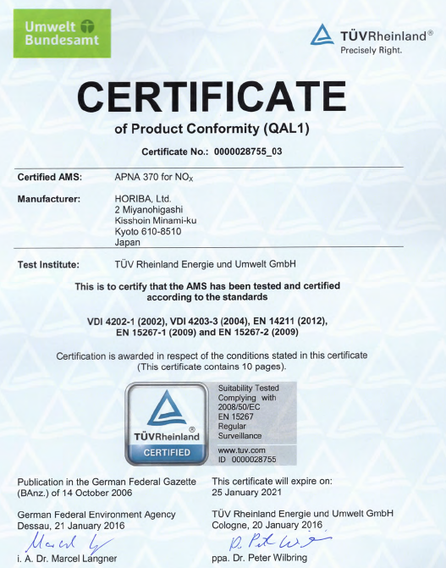
9.4 TYPE APPROVAL OF ANALYZER
European Union IPA 2013 Programme for Croatia
EXAMPLE: Type approvals for
NO/NOx analyzers
– HORIBA APNA 370
Institut za energetiku i zaštitu okoliša
Energy Research and Environmental Protection Institute

Slide 172
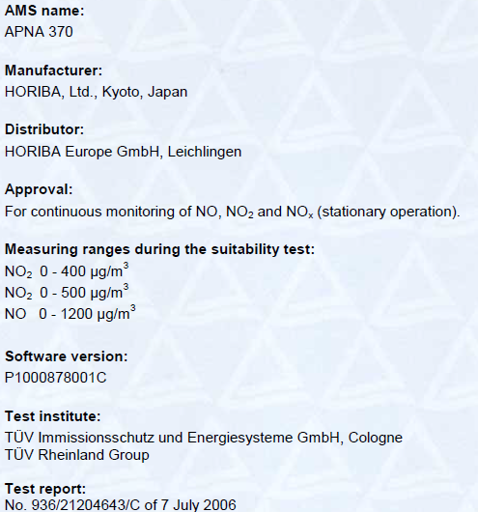
9.4 TYPE APPROVAL OF ANALYZER
European Union IPA 2013 Programme for Croatia
Institut za energetiku i zaštitu okoliša
Energy Research and Environmental Protection Institute

Slide 173
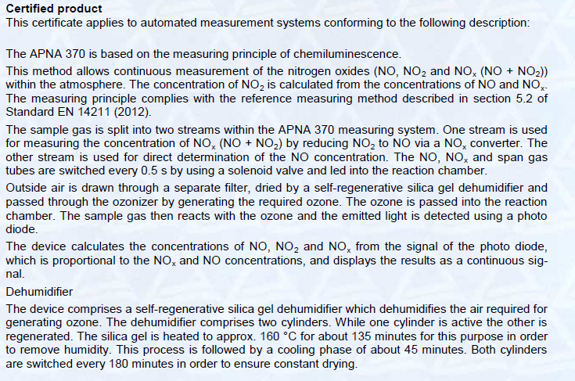
9.4 TYPE APPROVAL OF ANALYZER
European Union IPA 2013 Programme for Croatia
Institut za energetiku i zaštitu okoliša
Energy Research and Environmental Protection Institute

Slide 174
9.4 TYPE APPROVAL OF ANALYZER
European Union IPA 2013 Programme for Croatia
Type approvals for various analyzers:
HORIBA APNA 370 (NO/NOx) – TUV Rheinland, Certificate No. 0000028755-03
HORIBA APMA 370 (CO) – TUV Rheinland, Certificate No. 0000028754-03
HORIBA APOA 370 (O3) – TUV Rheinland, Certificate No. 0000028756-03
HORIBA APSA 370 (SO2) – TUV Rheinland, Certificate No. 0000028757-03
Institut za energetiku i zaštitu okoliša
Energy Research and Environmental Protection Institute

Slide 175
THANK YOU FOR YOUR ATTENTION
Energy Research and Environmental Protection Institute
Disclaimer: The contents of this publication are the sole responsibility of EKONERG – Energy Research and Environmental Protection Institute, Ltd. and can in no way be taken to reflect the views of the European Union
This project is funded by the European Union

